Slide 1
WRITING EFFECTIVE PARAGRAPHS
sandra.sembel@uph.edu

Slide 2
Effective Paragraph
An effective paragraph should be unified, coherent, systematically organized and well developed.
1
Unified
2
Coherent
3
Systematically organized
4
Well-developed (sufficient support)
Notes:
Paragraphs are unified around a main point, and all sentences in the paragraph should clearly relate to that point in some way.
All ideas and sentences are coherently connected to one another.
The ideas and sentences are systematically organized (cause – effect, list of examples, steps, comparison and contrast, problem and solution, simple to complex)
Each point is sufficiently supported by relevant details.

Slide 3
Which one is a unified paragraph?
Paragraph A
Club Palm Resort's beaches are beautiful, and the surrounding countryside is quite scenic. The quality of the food leaves a lot to be desired. Many vacationers enjoy the variety of outdoor activities and the instruction available in such sports as sailing and scuba diving. Unfortunately, security is poor; several vacationers' rooms have been broken into and their valuables stolen. Christmas in the Bahamas can make the thought of New Year's in Chicago bearable.
Paragraph B
For vacationers sick and tired of the frozen north, a week at Club Palm Resort can provide just the midwinter benefits they need. Club Palm Resort's beaches are beautiful, and the surrounding countryside is quite scenic. Many vacationers also enjoy the variety of outdoor activities and the instruction available in such sports as sailing and scuba diving. Christmas in the Bahamas can make the thought of New Year's in Minneapolis bearable.
The unified paragraph is: □ Paragraph A □ Paragraph B

Slide 4
Which one is the coherent paragraph?
Paragraph C
Club Palm Resort's isolation created dissatisfaction among some vacationers. Many people expect to be able to go out for a meal if they feel like it, but the club's location far from populated areas made that impossible. To make matters worse, the quality of the food was poor. The isolated location also forced people to spend all their time together-day after day. By evening nearly everyone was ready for a choice of food, entertainment, and company.
Paragraph D
Club Palm Resort's isolation created dissatisfaction among some vacationers. The quality of the food was poor. People want a choice of entertainment in the evening. Most of us spent too much time together day after day. People expect to be able to go out for a meal if they feel like it.
The coherent paragraph is: □ Paragraph C □ Paragraph D

Slide 5
Which paragraph is well-developed?
Paragraph F
A midwinter vacation at Club Palm Resort has its good points and bad points. The beaches are clean and uncrowded. The surrounding countryside is lush and soothing to winter-weary eyes. Furthermore, being able to take sailing and scuba diving lessons, while friends back home shovel snow, makes the outdoor activities extra-enjoyable. On the other hand, several features of Club Palm Resort are substandard. The food is poor, and, because the club is isolated, eating elsewhere is impossible. Security could also be better, as thefts from several guests' rooms indicated. So, for some vacationers, nice scenery and fun activities may not be enough to offset the possibility of poor service and lax security.
Paragraph E
A vacation at Club Palm Resort has its good points and bad points. People need to weigh the good points and bad points before they choose to go there. The beaches are nice, but they may not be enough for some vacationers.
The unified paragraph is:
□ Paragraph E
□ Paragraph F

Slide 6
Which Paragraph is the most systematically organized
Paragraph G
Horses are farm animals used to carry heavy loads. We can find horses in the farm, helping farm owners to do the farm works. The farmers also use horses to carry people and goods from one place to another. No wonder, horses are known as beasts of burden. Horses live in a stable. They are very useful animals.
Paragraph H
The Dog is a pet animal. It is one of the most obedient animals. There are many kinds of dogs in the world. Some of the are very friendly while some of them a dangerous. Dogs are of different color like black, red, white and brown. Some old them have slippery shiny skin and some have rough skin. Dogs are carnivorous animals. They like eating meat. They have four legs, two ears and a tail. Dogs are trained to perform different tasks. They protect us from thieves and guarding our house. They are loving animals. A dog is called man's best friend. They are used by the police to find hidden things. They are one of the most useful animals in the world.
The systematically organized paragraph is:
□ Paragraph G
□ Paragraph H

Slide 7
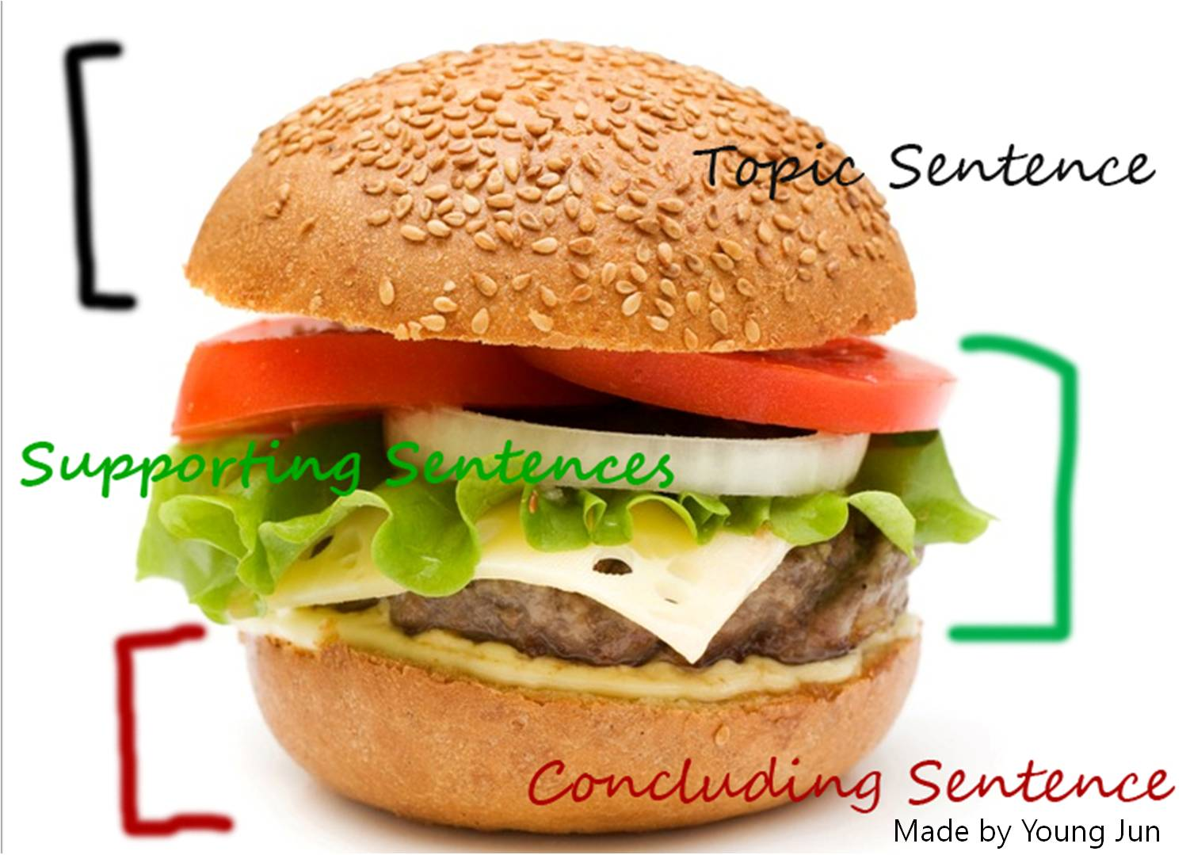
Effective Paragraph: The rule of 3

Slide 8
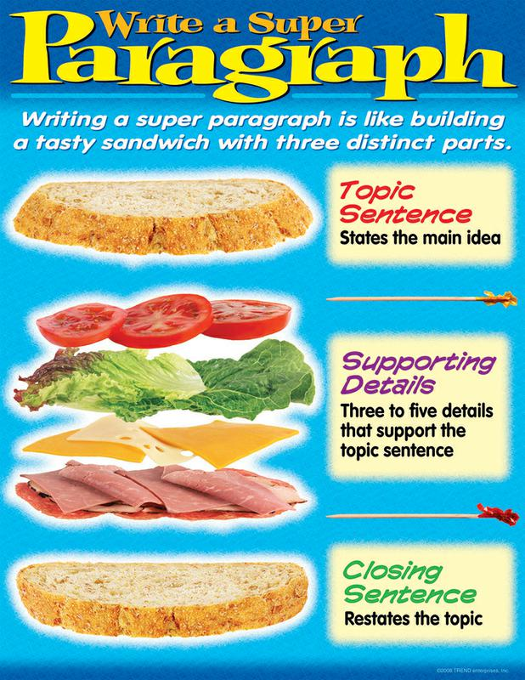

Slide 9
4 Steps to Paragraph Writing
1
Make a point
2
Back up your point
3
Organize the support
4
Write clear, error-free sentences

Slide 10
Topic Sentences

Slide 11
2 Elements of an effective topic sentence
1
Topic
Main idea
2
Controlling idea
Attitude/opinion
Supporting ideas

Slide 12
Examples
Professional athletes are overpaid because of three reasons.
Topic : Professional athletes
Attitude or opinions: Overpaid
Supporting ideas: three reasons

Slide 13
Other examples
Living in a small town is preferable because of its many advantages.
Topic?
Attitude or opinions?
Supporting ideas?

Slide 14
Try this: For each topic sentence, identify the topic and controlling idea (attitude/opinion, supporting ideas)
Use of cellphone in class should be banned due to its damaging impacts.
Losing my job last year turned out to be good for me.
Pollution causes social, health and economic problems in Jakarta.
Learning to write effectively is not difficult if you know the key strategies.
People with low self-esteem often need to criticize others for a number of reasons.

