Slide 1
Unit 1. First Impressions

Slide 2
Warming Up
What’s your first impression about the person?
Do you think he is experienced or inexperienced doctor?
How can you tell?
Can you trust this person?

Slide 3
What about this person?
What do you think about him?
Can you trust him?

Slide 4
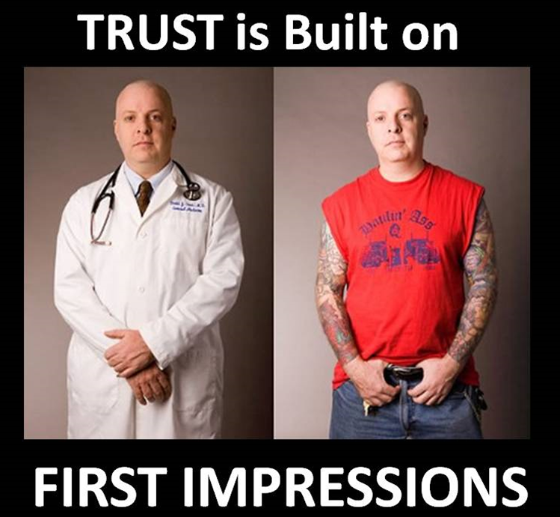

Slide 5
Let’s Read an interesting article about First Impression.

Slide 6
Reading Comprehension
Academic connections 1
Unit 1: First Impressions and Attractions

Slide 7
First Reading: Read silently and write down a maximum of 5 words that you don’t understand.
Work with your friends to find the meanings.
Are there still words that you don’t understand? We will discuss them.

Slide 8
Second Reading: Read again and try to answer the questions on page 7.

Slide 9
The Power of First Impressions
Paragraph 1
When people meet for the first time, they make first impressions of one another in a few seconds. To do this, they notice clothes, body shape, the way a person talks, and expressions he or she makes. Research shows that first impressions are very important because they have a strong impact on forming relationships.

Slide 10
Questions for Paragraph 1
How much time do people need to make first impressions?
What do people notice in others to get first impressions?
Why are first impressions important?

Slide 11
Paragraph 2
Studies show that the primacy effect is an important part of first impressions. The primacy effect is the idea that the first impression is very difficult to change. After the first meeting, two people may interact again and learn more about each other, but the early impressions they formed will influence their feelings about each other in the future. For example, if a person has a good first impression of someone, he or she probably will not notice bad things about the person later. However, if that person has a bad first impression, he or she will probably notice mostly bad things in the future.

Slide 12
Questions for Paragraph 2
What is “Primacy Effect”?
Why is it important?
Can you give examples of Primacy effect?

Slide 13
Paragraph 3
Another interesting part of first impressions is that people act how others expect them to act. This is called a self-fulfilling prophecy. Research by Snyder and Swann supports this idea (1978). In that study, partners played a game together. The partners did not know one another, so the researchers told each player about his partner.

Slide 14
… 3
Sometimes they said positive, or good things about a partner. Sometimes they said negative or bad things. The result of the study showed that players acted friendly when they expected their partners to be friendly, but they acted unfriendly when they expected their partners to be unfriendly. (See Figure 1.1) The players’ expectations influenced how they acted toward one another.

Slide 15
Questions for Paragraph 3
What is ‘self-fulfilling prophecy’?
Who conducted a research about this?
What is the result of the research?

Slide 16
Paragraph 4
A related study by Michael Sunnafrank (2004) showed that when people first meet, they quickly make predictions about what kind of relationship they will have. Sunnafrank found that these predictions had a strong impact on future relationships. In his study of 164 first-year college students, Sunnafrank found that when students predicted they could be friends, they sat closer together in class and interacted more. As a result, they actually became friends. In other words, they mad their predictions come true.

Slide 17
Questions for paragraph 4
According to Michael Sunnafrank’s study, what do people quickly make when they first meet people?
Why are these predictions important?
Can you give more explanation about Sunnafrank’s study? (How many respondents are involved?; what is the result of the study?)

Slide 18
Paragraph 5
Clearly, first impressions are very important in forming relationships, because they influence the expectations people have of one another and how they behave toward one another.
Snyder. M., & Swann, WB (1978). Behavioral confirmation in social interaction: From social perception to social reality, Journal of Experimental Social Psychology, 14; 148-162
Sunnafrank, M., & Ramirez, A (2004). At first sight: Persistent relational effects of get-acquanted conversations. Journal of Social and Personal Relationship

Slide 19
Questions about Paragraph 5
Are first impressions important in forming relationships?
Why are first impressions important?

Slide 20
More Comprehension Questions

Slide 21
Number 1
Which statement contains the main idea of the essay?
When people meet for the first time, they make first impressions of one another in a few seconds.
To do this, they notice clothes, body shape, the way the person talks and expressions he or she makes.
Research shows that first impressions are very important because they have a strong impact on forming relationships.

Slide 22
Matching Paragraphs and Main ideas (note: two paragraphs have the same main idea)
People’s expectations can influence how a person acts.
First impressions are very important in forming relationships.
A first impression is not easy to change.
People act on their predictions to make the relationship they expect.
2. Paragraph 1: _____
3. Paragraph 2: _____
4. Paragraph 3: _____
5. Paragraph 4: _____
6. Paragraph 5: _____

Slide 23
Writing

Slide 24
Writing Task
Now, write what you think will influence the first impression! (Pick 3 points to discuss in your essay)
In our opinion, the following three points can influence first impression. First, ____. (Reason and example 1). Another influencing factor is ____. (Reason and example 2). Finally, _____ can influence first impression. (Reason and example 3). Therefore, to make good first impression, we need to ____, ___ and ___

Slide 25
sandrasembel.weebly.com
English language learning
General English
Assignment 1 -- Submit

Slide 26
Thank you!

