Slide 1
Unit 1 Advertising

Slide 2
1. Infomercial

Slide 3
Infomercial
On television, an infomercial is a short or regular-length television program that combines information presentation with an integrated suggestion to buy a particular product or service.
Exercise equipment and correspondence courses are two products sometimes sold through infomercials.
In the print media, the equivalent to an infomercial is the multi-page "advertising supplement" that is formatted to look like the news part of the medium and contains real information content
(Source: Whatis.com -- http://whatis.techtarget.com/definition/infomercial)

Slide 4
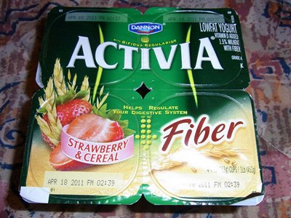
2. False claims
The court ordered Danon to pay the damage to the consumers up to $45 billion for making false claims about the nutritional benefits of its Activia brand yogurt. (source: ABC News)

Slide 5
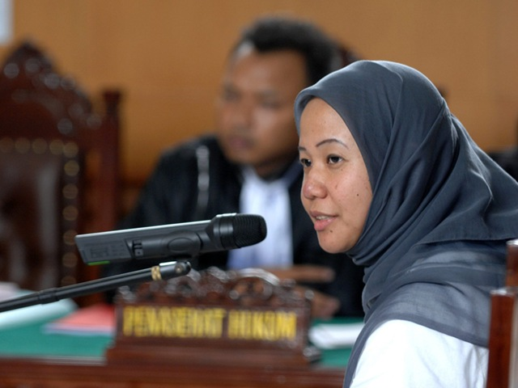
3. To be held liable for
Prita was held liable for her statement that she posted on social media about a hospital in South Jakarta.

Slide 6
4. Ab machine
You have to learn to use the Ab machine at the gym to strengthen abdominal muscles.

Slide 7
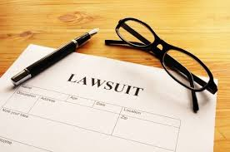
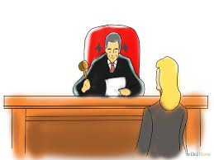
5. To sue someone
To use a legal process to take someone to court for his /her wrongdoing
Example: The patient sued the doctor for malpractice.

Slide 8
6. Come On!
Michael: I'm not sure I want to do this. Gob: Come on!
The single most persuasive phrase in the English language.

Slide 10
7. Exaggerate

Slide 11
7. Exaggerate
To describe something as being larger, bigger, better or worse that it really is.
Example:
He said he had 20 luxury cars and 5 houses. I think he exaggerated it.

Slide 12
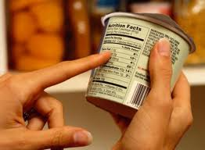
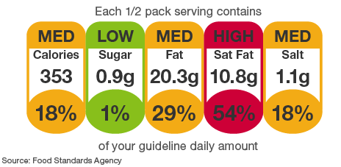
8. Read the fine prints on the label

Slide 13
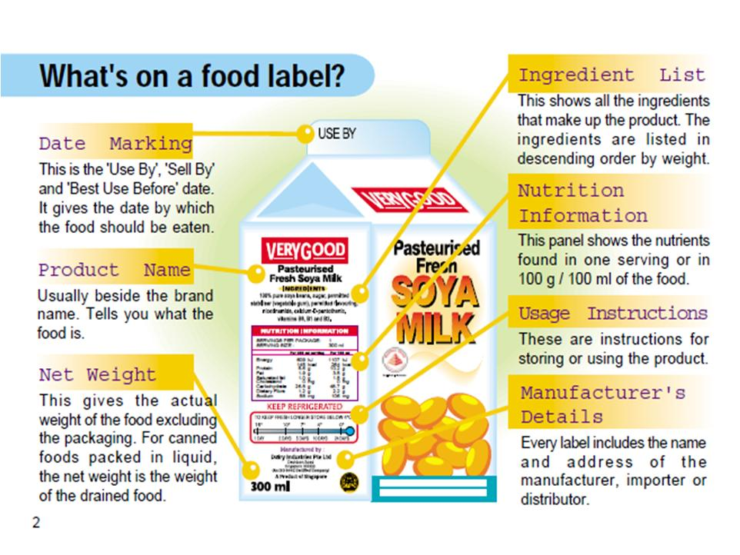

Slide 14
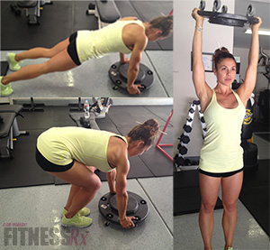
9. To vary
To be different, to become different, to make slightly different
Example: You need to vary the workout movements

