Slide 1
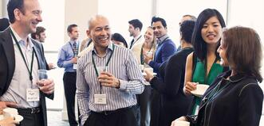
Meeting New People
sandrasembel.weebly.com
English language learning/English for Business School

Slide 2
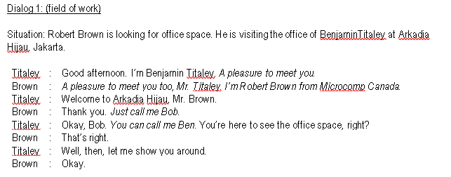
Model Dialog 1

Slide 3
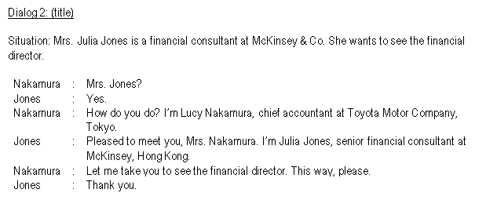
Model Dialog 2

Slide 4
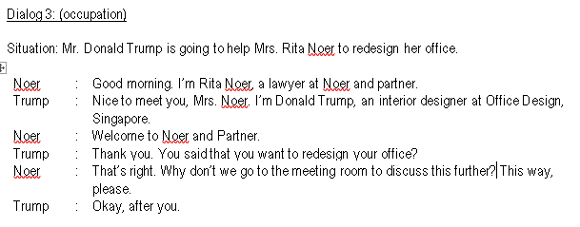
Model Dialog 3

Slide 5
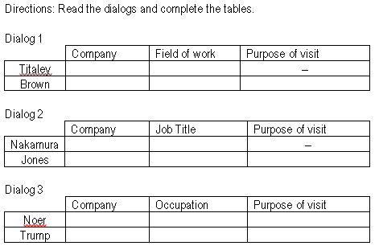
Activity 1

Slide 6
Activity 2

Slide 7
Activity 3
Name of a famous person you admire the most
01
Dream Country
02
Dream profession
03
Dream company
04

