Slide 1
Synthesizing: Try this!

Slide 2
Cyber Bullying

Slide 3
1
Insight?
http://www.edtechmagazine.com/k12/article/2012/07/cyberbully-takedown-infographic

Slide 4
2
Insight?
http://www.edtechmagazine.com/k12/article/2012/07/cyberbully-takedown-infographic

Slide 5
3
Insight?

Slide 6
Stroke

Slide 7
4
Insight?
http://www.qbi.uq.edu.au/stroke/facts-and-figures

Slide 8
5
Insight?
http://www.cdc.gov/globalhealth/infographics/world_stroke_campaign_campaign.htm

Slide 9
6
http://www.qbi.uq.edu.au/stroke/facts-and-figures
Insight?

Slide 10
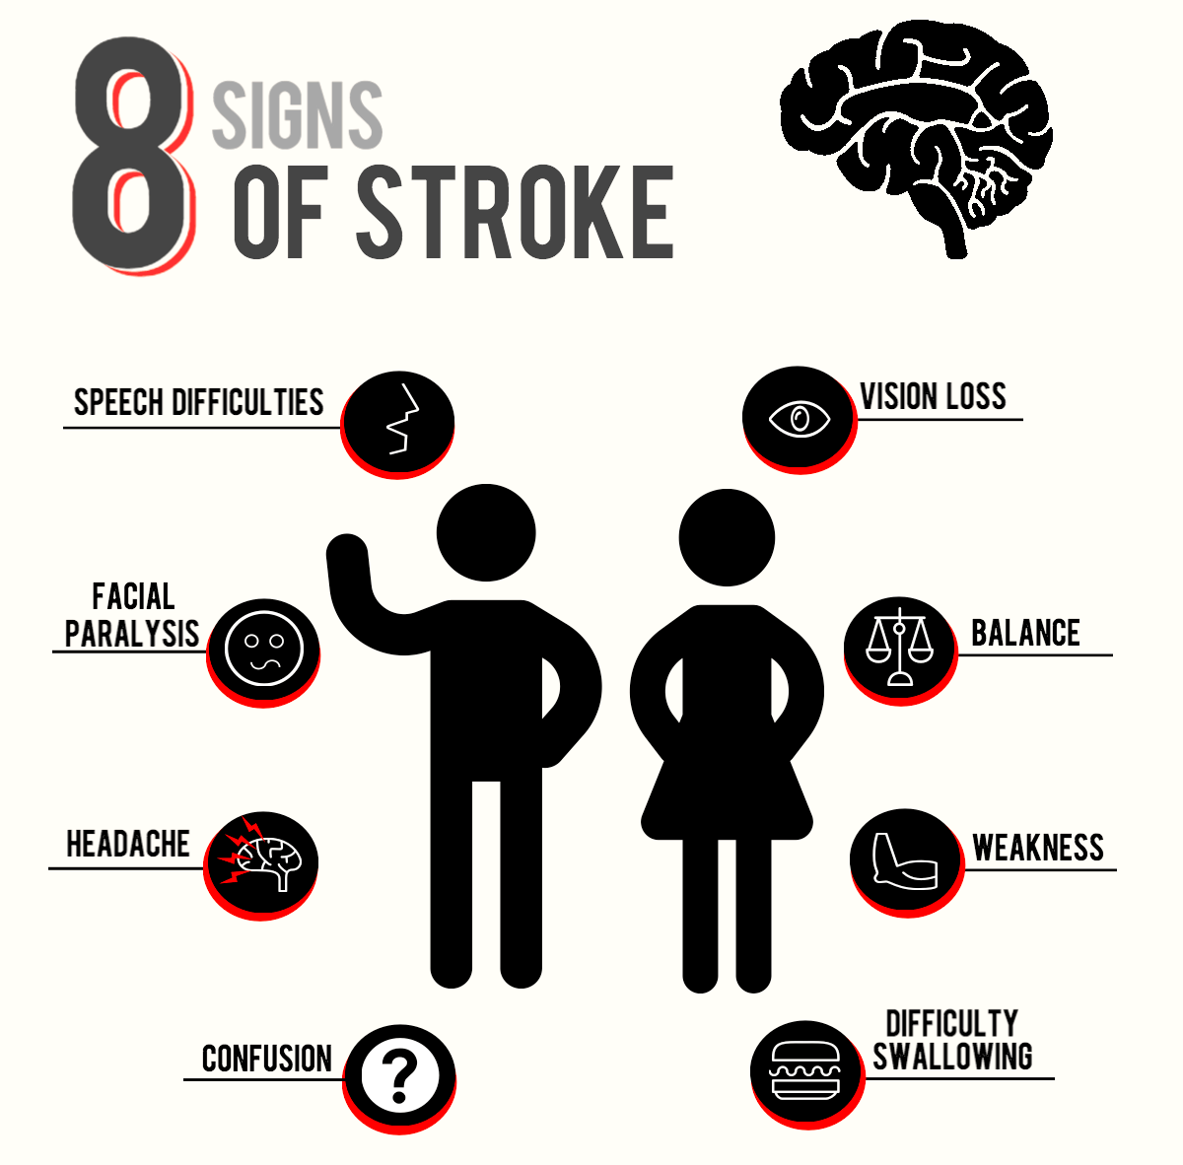
7
Insight?
http://www.qbi.uq.edu.au/stroke/signs-and-symptoms

