Slide 1
SKIMMING

Slide 2
Guessing the Main Idea

Slide 3
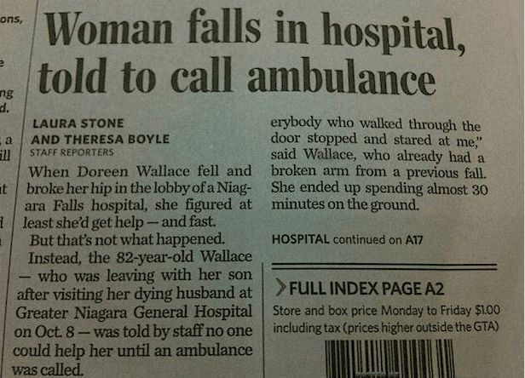
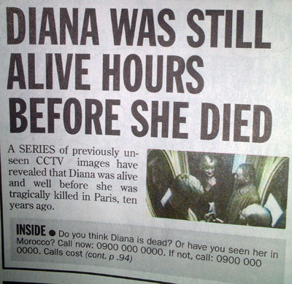

Slide 4
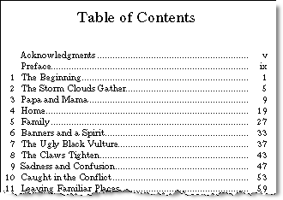

Slide 5
Skimming Practice 1
With your partner, decide which flyer will you choose to read. Why?

Slide 6
Skimming Practice 2
With your partner, skim the poster and discuss what the poster is about.

Slide 7
Listening:
Listen to the podcast and get the main idea of it.

Slide 8
TRUE / FALSE:
Listen to the listening passage carefully. Decide if statements below are true (T) or false (F).
The WHO recognized too much gaming as a mental disorder. T / F
Gaming addiction is now on the WHO's official list of diseases. T / F
Gaming is not a disorder if the gamer has played for less than a year. T / F
Gamers usually stop gaming when they suffer negative consequences. T / F
The WHO said all doctors know about the dangers of gaming. T / F
The WHO said that most people who drink alcohol have a disorder. T / F
The WHO said overuse of games can bring about adverse effects. T / F
The WHO said billions of people around the world are hooked on gaming. T / F

Slide 9
Online Reading Quiz
Practice:
http://wps.pearsoned.co.uk/ema_uk_he_price_effectivestudy_1/84/21617/5534086.cw/content/index.html

