Slide 1
SKIMMING

Slide 2
Guessing the Main Idea

Slide 3
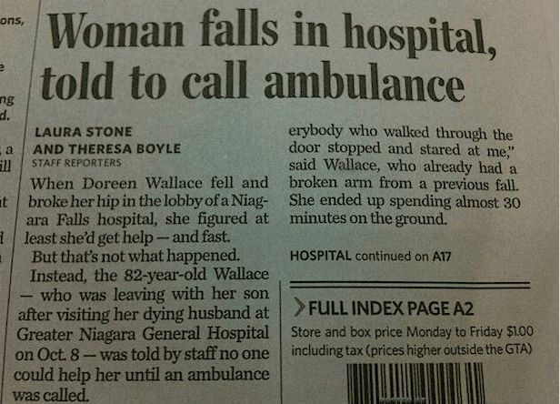

Slide 4
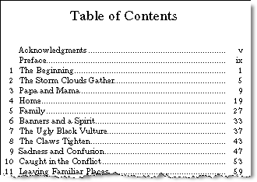

Slide 5
Skimming Practice 1
With your partner, decide which flyer will you choose to read. Why?

Slide 6
Skimming Practice 2
With your partner, skim the poster and discuss what the poster is about.

Slide 7
Listening:
Listen to the podcast and get the main idea of it.

Slide 8
Practice:
http://wps.pearsoned.co.uk/ema_uk_he_price_effectivestudy_1/84/21617/5534086.cw/content/index.html

