Slide 1
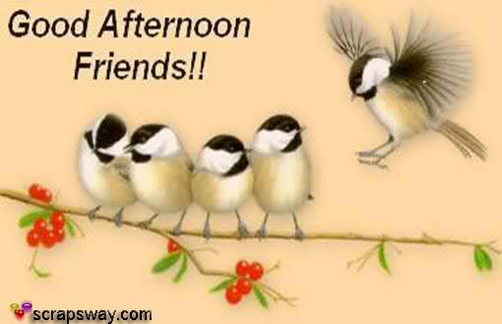

Slide 2
Using Context Clues

Slide 3
Initiative?
Ability to take charge
Plan to continue
Task to complete

Slide 4
Terminate?
Start
Continue
End

Slide 5
Amplifies?
Increase
Decrease
Adjust

Slide 6
Curtail?
Improve
reduce
Stop

Slide 7
Degraded?

Slide 8
Practice Using Context Clues

Slide 9
Quiz 1

Slide 10
Number 1
Archaeologists work carefully, painstakingly, and meticulously through dust and dirt to find the smallest fragment of the past.
With honesty and wisdom
With speed and strength
With patience and accuracy
With joy and happiness

Slide 11
Number 2
I saw Sharon this morning. I waved at her but she didn’t seem to see me because she was engrossed in a conversation with the lecturer.
Having serious discussion
Answering questions
Listening to
Taking very good care of

Slide 12
Number 3
Tony and his twin brother Donny have the similar interests in many aspects, except food. When dealing with food, they are always in discord.
permission
prohibition
approval
disagreement

Slide 13
Number 4
After the erratic results of the first test, a second test was ordered in which the patient's heartbeat appeared to be regular and normal.
unfair
inappropriate
irregular
uncomfortable

Slide 14
Number 5
Many of us have ambivalent feelings about our new country leader, admiring but also disliking him.
wise
mixed
pleasant
approving

Slide 15
Number 6
The adverse effects of this drug, including dizziness, nausea, and headaches, have caused it to be withdrawn from the market.
harmful
profitable
useful
careful

Slide 16
Number 7
I prefer the occasional disturbance of ear-splitting thunder to the non-stop dripping of our kitchen sink.
Very pleasant
Very painful
Very loud
Very thoughtful

Slide 17
Number 8
Nocturnal creatures, such as bats and owls, have highly developed senses that enable them to function in the dark.
Having a lot of feather
Eating plants
Coming out at noon
Active at night

Slide 18
Number 9
Mundane activities such as doing the laundry or dishes or groceries shopping or reading the newspaper all help me relax.
Carefree
Painful
Ordinary
Expensive

Slide 19
Number 10
Today I had to deal with one mishap after another. I couldn’t find my car keys, I dropped a bowl of soup at lunchtime, and my computer crashed twice.
question
accident
activities
assignment

Slide 20
Quiz 2: try it yourself

Slide 21
Guess the meaning of the bold printed words
Mars is a frozen red desert whipped by tornadoes and fierce winds.
“The closer he got to Father, the more he dreaded asking for some money. He was sure Father would not give it to him.”
I wanted to just set the table and be done with it, but my mother scrupulously arranged each napkin, dish, and utensil until they were in perfect alignment.

Slide 22
4. Grandpa didn’t know that Suzie was coming along on the fishing trip, and now he had to alter his plans.
5. Unlike Bob, who treated others rudely and kept to himself, Bobby was jovial, friendly, and outgoing.
6. Jake asked his mother for permission to go to his friend Rodney’s dance party, stating that his grades had improved, and he was quite pleased when she consented.

Slide 23
7. The lady decided that it was tea time and so, by jingling a tiny silver bell, she beckoned her servants to attend.
8. John may have been excited about becoming an artist, but his mother was waiting to see if he’d see this endeavor through before buying him the expensive paint kit.

Slide 24
9. My mom wanted to get the red napkins for the party and my dad wanted the blue napkins, but I’m not even concerned about such frivolous things.
10. Alice finally threw the withering roses away when a dead petal fell into her cereal bowl.

Slide 25
Key Points to remember!
When you find an unfamiliar word, use the clues from the context to guess the meaning of the word.
Use what you know to guess what you don’t know!

Slide 26
Sources
https://umdrive.memphis.edu/mniemann/www/assignment5/idfour.html
http://www.townsendpress.com/uploaded_files/tinymce/reading%20series/I5e_Chap1_Vocab_SE.pdf

