Slide 1
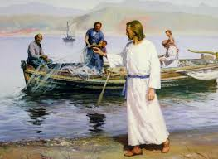
On the Same Boat

Slide 2
Introduction
Many people wanted to hear what Jesus had to say. Some were merely curious but others committed themselves to following Jesus as a disciple. Wherever you are on your spiritual journey, Jesus wants to be involved in your life.

Slide 3
Luke 5: 1-11
1 One day as Jesus was standing by the Lake of Gennesaret, the people were crowding around him and listening to the word of God. 2 He saw at the water's edge two boats, left there by the fishermen, who were washing their nets. 3 He got into one of the boats, the one belonging to Simon, and asked him to put out a little from shore. Then he sat down and taught the people from the boat.

Slide 4
Questions
Whose boat did Jesus choose?
Did the owner allow Jesus to use his boat?
What did Jesus told the owner of the boat to do with the boat?
What did Jesus do from the boat?

Slide 5
4 When he had finished speaking, he said to Simon, "Put out into deep water, and let down the nets for a catch.“ 5 Simon answered, "Master, we've worked hard all night and haven't caught anything. But because you say so, I will let down the nets.” 6 When they had done so, they caught such a large number of fish that their nets began to break. 7 So they signaled their partners in the other boat to come and help them, and they came and filled both boats so full that they began to sink.

Slide 6
Questions
What did Jesus ask Simon to do when He had finished speaking? What for?
What did Simon say to respond to this instruction? What did Simon do?
What happened after Simon obey what Jesus told him to do?
Did Simon keep the fish for himself? What did he do?

Slide 7
8 When Simon Peter saw this, he fell at Jesus' knees and said, "Go away from me, Lord; I am a sinful man!” 9 For he and all his companions were astonished at the catch of fish they had taken, 10 and so were James and John, the sons of Zebedee, Simon's partners.
Then Jesus said to Simon, "Don't be afraid; from now on you will fish for people." 11 So they pulled their boats up on shore, left everything and followed him.

Slide 8
Questions
What did Simon do after receiving blessings from Jesus?
What important new status or job did Jesus give to Simon and his friends?
What happened in the end? Did they continue to catch fish? Did they leave everything and follow Jesus?

Slide 9
Message
Allow God to use your boat of life for His mission to bless people.
When we allow God to use us, God will take care of us.
Sometimes God allows us to do something beyond our wisdom – doesn’t match our rational thinking. Just trust Him. He knows what is best for us and will work in everything to bring good to us (Romans 8: 28).
When we obey God, miracles happen. Share the blessings to others.
When God touches our lives, everything else becomes less important – because we know He takes care of everything – our mindset is changed.

Slide 10
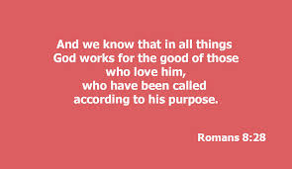
Romans 8: 28

