Slide 1
Pictures and paragraph writing

Slide 2
Questions
Place: where is it?
Time: What time of day is it?
People: Who are they?/Who is he/she?
Event: What is happening? What are the people doing?
Make a paragraph
Decide the title
The group decide the storyline and each member write a paragraph about it. → Assignment 2

Slide 3
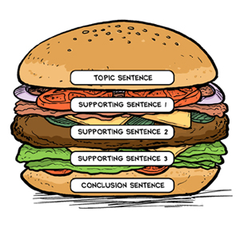
Parts of a paragraph
Main idea in a sentence
Opening:
Introduction
Topic sentence
Body:
Supporting details
Closing:
Conclusion
Final message (Hope)

Slide 4
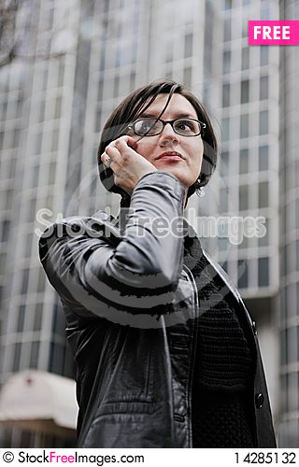
Who are they?/Who is he/she?
Where is it?
What time of day is it?
What is happening?
What are the people doing?
What will happen next?

Slide 5
Outline
Opening:
Introduction/Background
Susy is an employee.
She works at an advertising agency.
Main idea (Topic sentence):
She will have a lunch meeting with a client.
Body (Supporting details)
She is in front of her office.
She is making appointment on the phone.
She will meet with a client to talk about a new advertising project.
Closing:
She hopes the project will be successful.

Slide 6
Paragraph
Opening:
Introduction/Background
Susy is an employee.
She works at an advertising agency.
Main idea (Topic sentence):
She will have a lunch meeting with a client.
Body (Supporting details)
She is in front of her office.
She is making appointment on the phone.
She will meet with a client to talk about a new advertising project.
Closing:
She hopes the project will be successful.
This is Susy. She is an employee. She works at an advertising agency. Susy will have a lunch meeting with a client today. Susy is now in front of her office. She is making the appointment to meet her client on the phone. She will meet with a client at a coffee shop not far from Susy’s office to talk about a new advertising project. She hopes that the project will be successful.

Slide 7
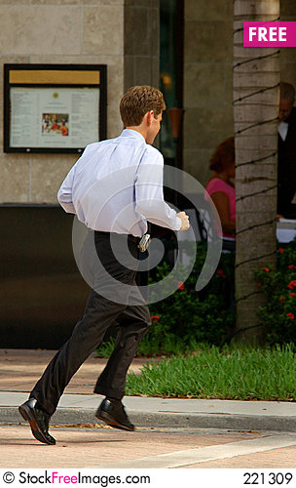
Who are they?/Who is he/she?
Where is it?
What time of day is it?
What is happening? What are the people doing?
What will happen next?

Slide 8
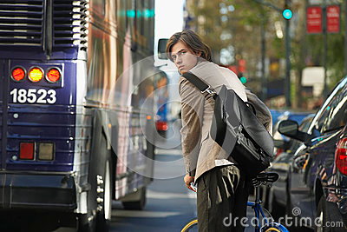
Who are they?/Who is he/she?
Where is it?
What time of day is it?
What is happening? What are the people doing?
What will happen next?

Slide 9
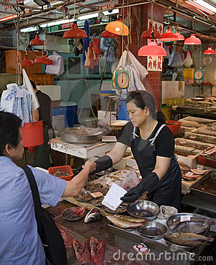
Who are they?/Who is he/she?
Where is it?
What time of day is it?
What is happening? What are the people doing?
What will happen next?

Slide 10
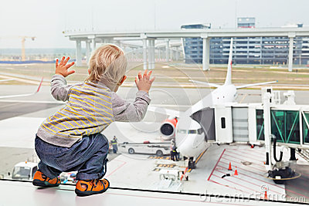
Who are they?/Who is he/she?
Where is it?
What time of day is it?
What is happening? What are the people doing?
What will happen next?

Slide 11
Who are they?/Who is he/she?
Where is it?
What time of day is it?
What is happening? What are the people doing?
What will happen next?

Slide 12
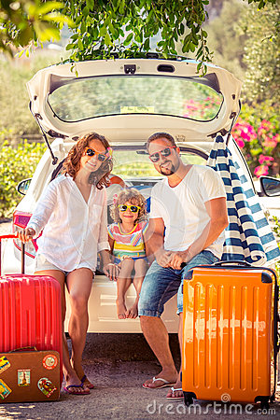
Who are they?/Who is he/she?
Where is it?
What time of day is it?
What is happening? What are the people doing?
What will happen next?

Slide 13
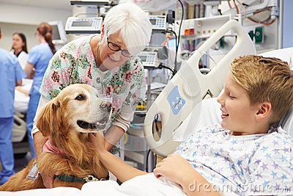
Who are they?/Who is he/she?
Where is it?
What time of day is it?
What is happening? What are the people doing?
What will happen next?

Slide 14
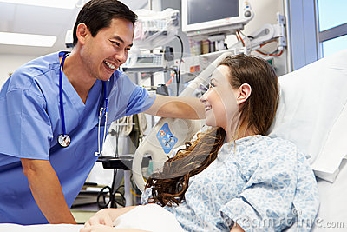
Who are they?/Who is he/she?
Where is it?
What time of day is it?
What is happening? What are the people doing?
What will happen next?

Slide 15
Who are they?/Who is he/she?
Where is it?
What time of day is it?
What is happening? What are the people doing?
What will happen next?

