Slide 1
Path-Goal Theory
Danet A. Patria
J. Sandra Sembel
Robert J House , Terence R. Mitchell, 1971

Slide 2
Discussion Scope
The Overview of the Theory
The Evolution of the Theory
The Review of the assigned journal

Slide 3
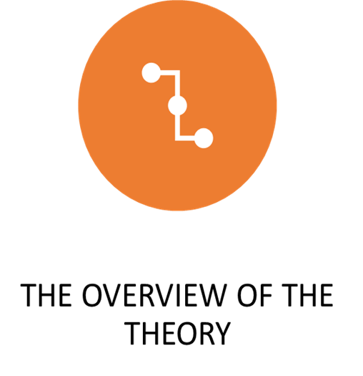

Slide 4
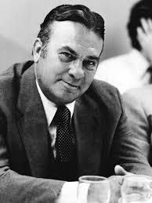
The Background
The path–goal theory, also known as the path–goal theory of leader effectiveness or the path–goal model, is a leadership theory developed by Robert House, an Ohio State University graduate, in 1971 and revised in 1996.

Slide 5
What is Path Goal Theory?
Path Goal Theory is a contingency leadership theory that indicates that the leader’s main objective is to provide guidance, support, and help necessary for subordinates to achieve their own goals effectively besides the organization goals. (C. Silverthorne. 2001)

Slide 6
The Basic Idea

Slide 7
According to this theory,
The effective leader compensates for deficiencies of his/her followers in order to overcome obstacles toward a goal, which in its turn increase followers’ intrinsic motivation (House, 1996).
The four leadership styles that function to minimize role ambiguity and provide reward for the followers are:
Directive
Supportive
Participative
Achievement oriented behaviors

Slide 8
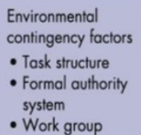
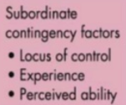
Contingency variables in Path-Goal Theory
Work environment
Characteristics of employees

Slide 9
Path-Goal Variables and Predictions

Slide 10
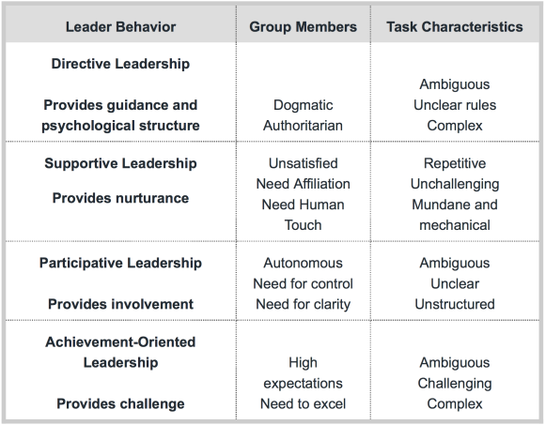
Leadership styles in path-goal theory
(Andersen, 2016)

Slide 11
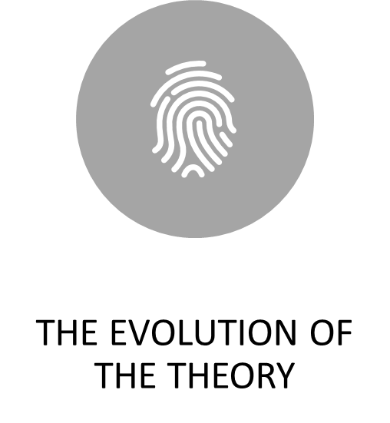

Slide 12
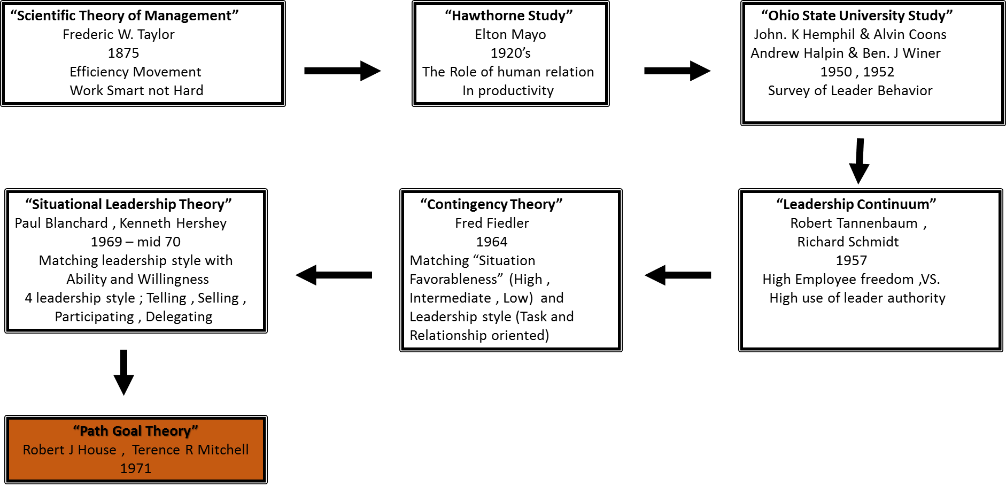
History

Slide 13
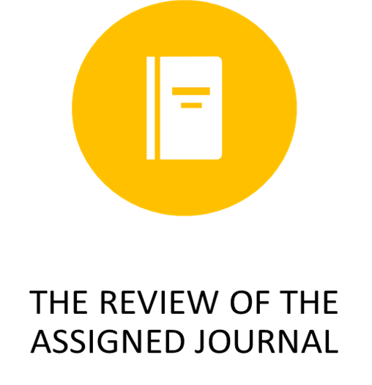

Slide 14
The Journal Article
2018

Slide 15
Background
One of the most important concerns a manager has, is whether they are assisting their key employees to reach their highest potential.
It takes over a year for a company to gain the full capacity of a newly hired salesperson, as knowledge about the product and target market takes time to learn and adjust to.
Therefore, strategically retaining a company’s present salesforce is a priority
One of the drivers of salesforce motivation that managers must understand is optimal goal setting. Though goals keep employees motivated, satisfied and productive (Locke and Latham, 1990)

Slide 16
Background
Employees (Sales people) reaching highest potentials
Manager’s Concern
Over 1 year
Knowledge about product and market
Retain employees
Manage motivation
OPTIMAL GOAL SETTING
Open communication
(Kim and Hammer, 1996)
External and internal human factors (Locke, 1996)

Slide 17
Previous Literature
Goals keep employees motivated, satisfied and productive (Locke and Latham, 1990)
The type of goal, as well as goal difficulty increases PERFORMANCE (Kim, 198; Latham & Blades, 1975; Locke et al., 1970)
Optimal goal setting can be challenging for managers (Ordoñez et al., 2009).
To capture an understanding of optimal goal setting for their salesforce, open COMMUNICATION is a must (Kim and Hamner, 1976).
Open Communication might not capture the effect of attitudes and emotions on the extent to which a salespersons can achieve their goals. (Gap 1)

Slide 18
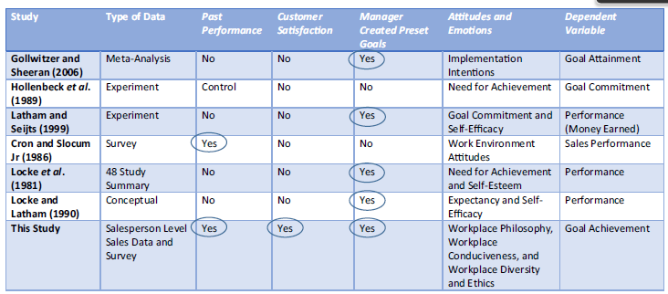
Past Research (Literature Overview)

Slide 19
Past Research
Goal Setting
Goal Attainment
Emotion
Goal Attainment
Cannot be studied independently

Slide 21
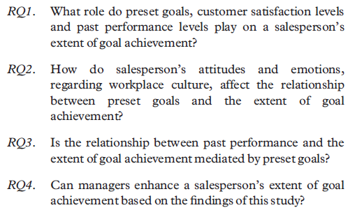
This research
Goal Setting Theory
(Stryker and Burke, 2000)
and
Identity Theory, (Miner, 2005)

Slide 22
Purpose of the study
Purpose: The purpose of this study is to understand how a salesperson’s preset goals, customer satisfaction levels and past performance affect the extent of goal achievement, as well as how job-specific attitudes and emotions affect the relationship between preset goals and goal achievement.

Slide 23
Design/methodology/approach
This study uses a modelling framework with both main, moderating and mediating effects, using transaction data and survey results from a telecommunications firm
Regression model.
Salesperson’s cross-sectional data set from a national telecommunication data set
1399, 2011

Slide 24
Conceptual Framework
V. Kumar, Ashley Goreczny, Todd Maurer, (2018) "What drives a salesperson’s goal achievement? An empirical examination",
Journal of Business & Industrial Marketing, Vol. 33 Issue: 1, pp.3-18,

Slide 25
Findings
The results indicate that pre-set goals and customer satisfaction, interestingly, have an inverted-U relationships with goal achievement.
Further, attitudes and emotions regarding workplace conduciveness and workplace ethics and diversity, reduce the effect pre-set goals have on goal achievement.
However, attitudes and emotions regarding workplace philosophy strengthens the effect pre-set goals have on goal achievement, whereas with disagreement, this relationship diminishes.

Slide 26
Research limitations
Two of the primary limitations of this study are:
because of the cross-sectional nature of the study, there is limited opportunity to control for unobserved heterogeneity;
performance goal achievement, though is important for the firm, is one of many potential goals that affect a salesperson. For example, customer satisfaction goals or a one-time special event goals could play a role.
Therefore, only using performance goal achievement could be a limitation of this study.

Slide 27
Originality/value
This study contributes to academic literature in three ways.
First, it demonstrates the diminishing effect of customer satisfaction on goal achievement.
Second, it identifies an inversed U-shaped relationship between pre-set goals and goal achievement.
Finally, it examines how attitudes and emotions regarding workplace culture (conduciveness, ethics and diversity and philosophy) affect the relationship between pre-set goals and goal achievement.

Slide 28
What drives a salesperson’s goal achievement?
Goal Achievement
Goal Setting Theory (Latham and Seijts, 1999).
Identity Theory, (Burke)
Theory of Motivation (Two-factor Theory, Herzberg, 1959) – Hygiene, Satisfier
Leadership Theory: Contingency Theory (Fidler)
Behaviorism theory - Reinforcement
(Thorndike, 1898)
Personality Theory: Social Cognitive Theory (Bandura); Humanistic Perspective (Rogers)
Social Identity Theory, (Tajfel, 1979)
Social Capital Theory, (Putnam, 1993, 2000)

Slide 29
References
Kelley, R. and Caplan, J. (1992), “How bell labs creates star performers”, Harvard Business Review, Vol. 71 No. 4, pp. 128-139.
Locke, E.A. and Latham, G.P. (1990), “Work motivation and satisfaction: Light at the end of the tunnel”, Psychological Science, Vol. 1 No. 4, pp. 240-246.
Kim, J.S. and Hamner, W.C. (1976), “Effect of performance feedback and goal setting on productivity and satisfaction in an organizational setting”, Journal of Applied Psychology, Vol. 61No. 1, p. 48.
Miner, J.B. (2005), “Goal-setting theory”, Organizational Behavior 1: Essential Theories of Motivation and Leadership, Prentice-Hall, India, Chapter 10, pp. 159-183.
Myers, K.K. and Sadaghiani,. (2010), “Millennials in the workplace: A communication perspective on millennials’ organizational relationships and performance”, Journal of Business and Psychology, Vol. 25 No. 2, pp. 225-238.
Latham, G.P. and Seijts, G.H. (1999), “The effects of proximal and distal goals on performance on a moderately complex task”, Journal of Organizational Behavior, Vol. 20 No. 4, pp. 421-429.
Anderson, Paul (2016), What is Path-Goal Theory?, accessed: Nov 15, 2019, https://sites.psu.edu/leadership/2016/06/29/what-is-path-goal-theory/

Slide 30
Danet A Patria
J. Sandra Sembel

