Slide 1
Not your ordinary English Lessons: Three Fun Strategies with Amazing Results
Sandra Sembel
Learningpartnerships.weebly.com

Slide 2
What is the goal of English Language Learning?
Why do people Learn English?
Why do Indonesians Learn English?

Slide 3
Publish
Expand business
Traveling
Perform for international audience
Get hired
Get promoted
Enjoy entertainment
Get education
Support job
Immigration

Slide 4
Top 15 Goals
Immigrate into an English speaking country
Get hired at a first job
Be hired at a better company
Be promoted in your company
Sell and market your products to English speaking countries
Be able to operate a business completely in English.
Publish an authoritative business, scientific journal article in English
Be admitted and study in a North American university.
Be admitted and study in a North American university graduate program.
Travel independently in English speaking countries.
As an Artist, perform for English speaking audiences
Enjoy entertainment produced by English speaking artists
Use English instructions for computer applications. Surf the net in English
Score 950 on the Toeic test or 280 on the new TOEFL exam
Study English Literature in original text
http://eslincanada.wordpress.com/2007/09/08/top-15-goals-for-studying-english-as-a-second-language/

Slide 5
Ministry of Education in Malaysia
Self-development. The student becomes a 'better' person through learning another language.
Training new cognitive processes. By learning another language, students acquire methods of learning or new perspectives on themselves and their societies.
Appreciation of native language: students' awareness of their first language is enhanced by learning a second language.
An entrée to another culture. Students can come to understand other groups in the world and to appreciate the music and art of other cultures.
A form of religious observance. For many people a second language is part of their religion, whether Hebrew for the Jewish religion, Arabic for Muslims, or indeed English for Christians in some parts of the world.
Communicating with those who speak another language. We all need to cope with people from other parts of the world, whether for business or pleasure.
Intercultural understanding and peace. For some the highest goals of language teaching are to foster negotiation rather than war or changes in the society outside the classroom. (see for example Gomes de Matos, 2002)
http://homepage.ntlworld.com/vivian.c/Writings/Papers/EFLGoals.htm

Slide 6
External and Internal Goals (Cook, 1983; 2002)
EXTERNAL GOALS
INTERNAL GOALS
relate to the students' use of language outside the classroom:
travelling about using the second language in shops and trains, reading books in another language or attending lectures in a different country, surviving as refugees in a strange new world.
relate to the students' mental development as individuals;
they may think differently, approach language in a different way, be better citizens, because of the effects that the second language has on their minds; heightened people's cultural awareness.

Slide 7
of Learning

Slide 8
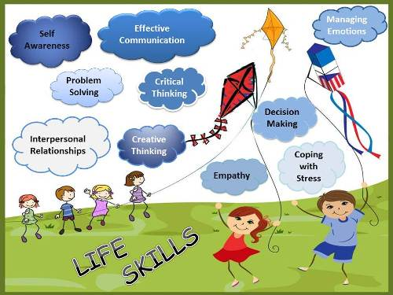
Wisdom 1: From Language skills to People Skills
Language skills
LQ
IQ
EQ
SQ
ICQ

Slide 9
Wisdom 2: Beyond the Classroom
Cultural values, skills, attitudes
Language Learning in the Classroom
❝Language is the road map of a culture. It tells you where its people come from and where they are going.❞ ‒Rita Mae Brown
Sandrasembel.weebly.com

Slide 10
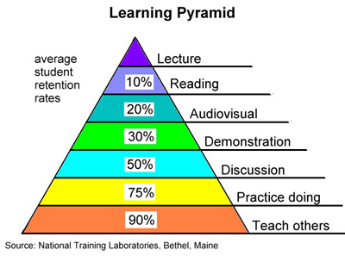

Slide 11
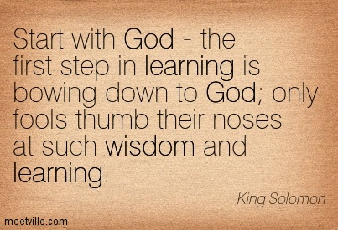

Slide 12
Three Fun Strategies with Amazing Results that apply the wisdoms of learning

Slide 13
Structure
Pre
During
Post
Preparing Students
Helping students understand
Checking Understanding
Applying skills
ENGAGE
IMMERSE
INTERACT

Slide 14
Engage
With the learning materials
With others

Slide 15
Immerse
Internalize
Experience
Connect

Slide 16
Grow
Apply
Share
Innovate

Slide 17
From Reading Text
Engaging
Picture Talk
Guessing
Predicting
Asking questions
Word Search
Immersing
Completing grid (table)
Rearranging (events, paragraphs)
Jigsaw reading
Story book
Role play
Diorama
Interacting
Chain story
If I were ...
A different ending
Changes (people, places, activities)
Opinions
Likes/dislikes
Suggestions/advice
Reading games
Interviewing (the author, the characters)

Slide 18
From Dialogs
Engaging
Guessing the topic
Answering questions
Immersing
Rearranging jumled words
Interacting
If I were ...
Completing missing information
Supplying responses
Asking question
Rearranging strips
Picture puzzle
Giving advice
Drawing
A letter to ...
Brainstorming
Summarizing
Role playing
Modifying context

Slide 19
Beyond the lessons
Share
Wall bulletin
Do
Class Project
Community service
Poster
Newsletter
Clasroom Wall of fame
Play or performance
Games
Inviting guest speaker

Slide 20
Final Message

Slide 21
Visit us at learningpartnerships.weebly.com

