Slide 1
Integrating Media Literacy in ELT at Universitas Pelita Harapan
Sandra Sembel

Slide 2
What is the number of internet users in Indonesia? (internetworldstats.com)
35 m
55 m
60 m
(India 196 m, Iraq 45 m)

Slide 4
Average number of hours spent on social media (world overview)
2.5 hours
3.3 hours
5.2 hours
10 hours

Slide 5
Youth and Cyberbullying (mediawisechoices.com)
43% of 13-17 year olds have been a victim of cyber bullying.
Only 10% of cyberbullying victims tell their parents.
Cyberbullying results in emotional damage that can last a lifetime. Some kids have committed suicide.

Slide 6
Lost in the Media?

Slide 7
We know all this but many remain ignorant. What about you?

Slide 8
We need to teach our children/students to be …..
MEDIA WISE!

Slide 9
MEDIA LITERACY IN ELT CLASSROOM
Authorship
Format
Target Audience
Content
Purpose

Slide 10
The Background
Three semesters – Accelerated semester
Shorter semester—the same amount of learning hours
Flipped classroom – media-rich learning strategies

Slide 11
STEP 1: LEARNING
Learning Subject Matter
Researching Subject Matter

Slide 12
STEP 2: LEARNING
Learning from the Teacher
Learning from other sources

Slide 13
STEP 3: SHARING (Publish or Perform)
Submit Class Assignments
Publish Assignments

Slide 14
Story Telling

Slide 15
Sharing

Slide 16
Advertisement for a Cause
Grace 03420110092
Adrian H.K 03420110039
Jackson G. 03420110029

Slide 17
Advertisement Concept
http://www.youtube.com/watch?v=pmZV36XgXaI

Slide 18
Why?
Indonesians don’t have the consciousness to donate their blood to others who need it. The blood is very important in some special cases for example:
Anemia
Pregnancy
Cancer
If we donate our blood we can save 3 lives. So we have to encourage people’s participation in the future blood donation events.

Slide 19
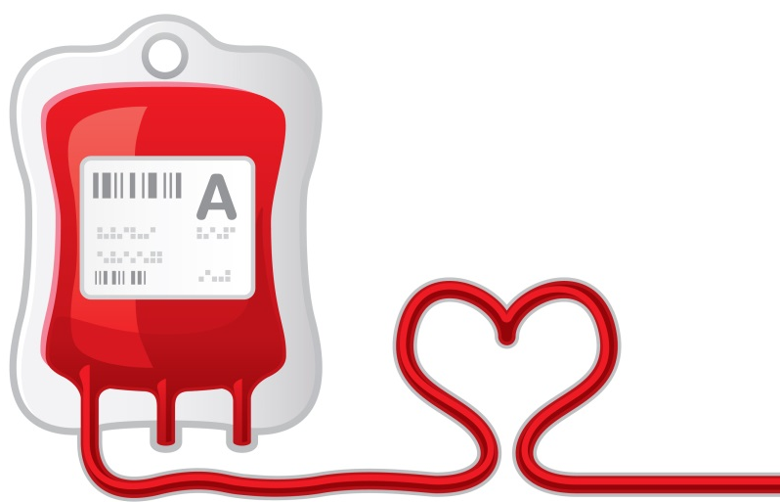
Continue
According to the statistics of:
Voice of America (VOA) news 9/9/14: “Indonesia lacks 1 million blood bags per year”
Republika online 18/2/13: “The amount of donors in Indonesia is below Malaysia and Singapore, with only 1.5% from the total Indonesian population”
Koran.com 14/10/11: “The amount of permanent donors in Indonesia, does not reach up to 1 million people”
Tempo.com 22/7/14: “PMI (Palang Merah Indonesia) of Bandung and Bekasi are shortage of blood bags”

Slide 20
Prepare students for their Future, not ours
“We must prepare young people for living in a world of powerful images, words and sounds.”
UNESCO, 1982

Slide 21
ELT, Quo Vadis?
MEDIA ELT LITERACY

Slide 22
INTEGRATE MEDIA LITERACY IN ELT CLASSROOMS
1. Formal Curriculum
2. Hidden Curriculum
Media Literacy culture
Media Literacy environment
Media wise choices

