Slide 1
IELTS WRITING TASK 1
(Describing a chart)

Slide 2
Strategies
Title and summary
Categories/
units
Interesting angles to bring out (3-4)
Closing

Slide 3
Writing Task 1
Describing a chart (bar chart, line graph, pie chart, table, map, diagram or process flow)
150 words
20 minutes

Slide 4
The Components:
Part 1. Opening
1
(1-2 sentences) Introduce the visuals
Part 2: Background
2
(2-4 sentences) General descriptions
Part 3: Interesting points
3
Conclusion
4
Comparison & contrast
Increase & decrease
Concluding statement
e.g. The charts display _____/ The diagram describes ____
e.g. The data show a constant/fluctuating increase in …… This trend occurred across all groups ……
e.g . The first state & last state; the trends in the highest & lowest group
End with the summary of the trend.

Slide 5
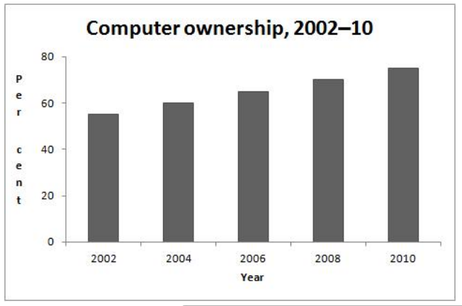
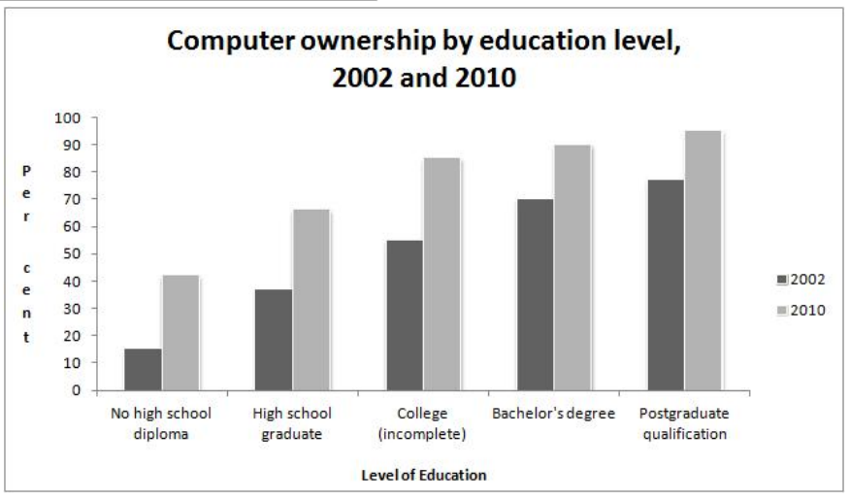
Writing Task 1: Computer Ownership
You should spend about 20 minutes on this task. The graphs below give information about computer ownership as a percentage of the population between 2002 and 2010, and by level of education for the years 2002 and 2010. Summarise the information by selecting and reporting the main features, and make comparisons where relevant. Write at least 150 words.

Slide 6
Rough outline
Computer ownership
Increasing trends
Analysis
Contrast: No high school diploma group vs. post graduate qualification group
Similarities:
High school degree - incomplete college graduates
Bachelor’s degree and post graduate qualification
Increasing trends

Slide 7
Part 1: Opening
(Reference: The Title) – 1 or 2 sentences.
State the title
The charts display _____
The diagram describes ____
The map illustrates ______
The table shows ____
Useful words/phrases:
Describe
Display
Illustrate
Show
Portray

Slide 8
Part 2: The background
(Reference: The summary – instructions)- 2 to 4 sentences
State the general trends
The data show a constant/fluctuating increase in ……
The trend occurred across all groups ……
Useful words/phrases:
Trends
Constant trend
Increasing trend
Decreasing trend
Fluctuating trend
Slight(ly) vs. Sharp(ly) – increase slightly (slight increase); increase sharply (sharp increase); moderate

Slide 9
Part 3: The Analysis of interesting points
Comparison & contrast
Increase & decrease
Analyze the first state & last state;
Analyze the trends in the highest & lowest group
Analyze the lowest point and the highest point
In 2002, slightly more than half the population owned computers. That number increased to roughly 75% over the next eight years.
Postgraduates were always ahead of the general population. While roughly three-quarters of postgraduates owned computers in 2002, that figure rose to nearly 95% by 2010.
By contrast, those who had not finished high school began with only a 15% computer ownership rate, which increased to about 45% after eight years.

Slide 10
Part 4: Conclusion
Concluding statement
End with the summary of the trend.
In conclusion, we learned from the graphs that the first decade of the 21st century saw steady gains in computer ownership among a variety of education levels.
Useful expressions:
In conclusion
In summary

Slide 11
1
The charts show rates of computer ownership from 2002-2010, including a more detailed look at ownership patterns by level of education.
These data show a constant increase in the percentage of the population that owned computers during the eight year timeframe. This rising trend occurred across all education levels. However, although having more education correlated directly with higher computer ownership percentages from 2002-2010, the ownership percentage increased most among those with the least education during those years.
2
In 2002, slightly more than half the population owned computers. That number increased to roughly 75% over the next eight years. Postgraduates were always ahead of the general population. While roughly three-quarters of postgraduates owned computers in 2002, that figure rose to nearly 95% by 2010. By contrast, those who had not finished high school began with only a 15% computer ownership rate, which increased to about 45% after eight years.
Notably, the three groups at the lowest end of the education spectrum saw the most significant computer ownership gains over this period. Their rate rose approximately 30 percentage points. College graduates and postgraduates saw more modest gains with 20 point increases between 2002 and 2010.
3
4
The first decade of the 21st century saw steady gains in computer ownership among a variety of education levels.

Slide 12
http://sandrasembel.weebly.com/toefl-prep_staff.html

Slide 13
Thank you!

