Slide 1
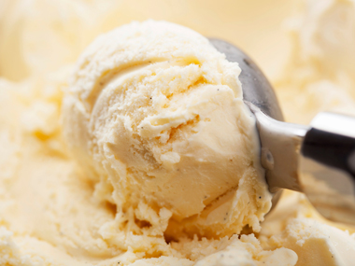
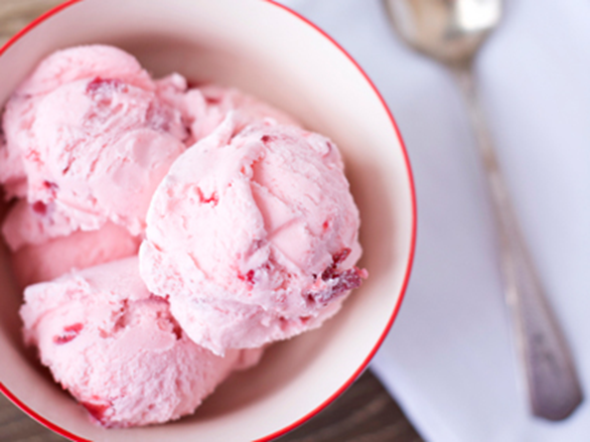
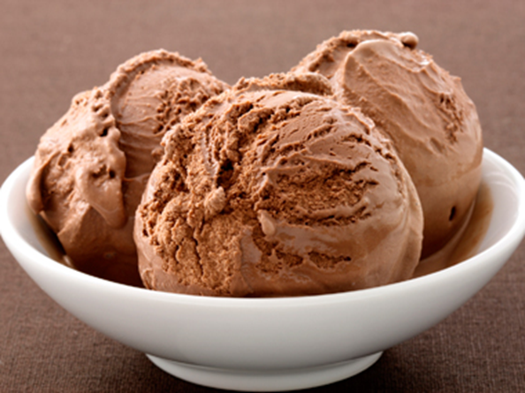
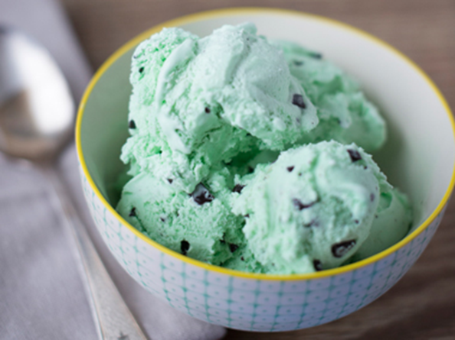
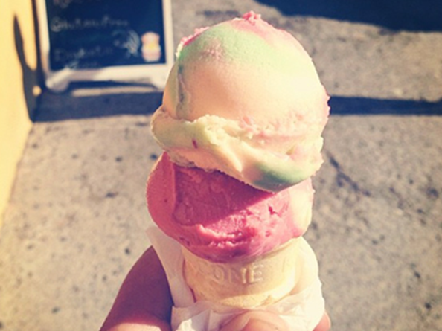
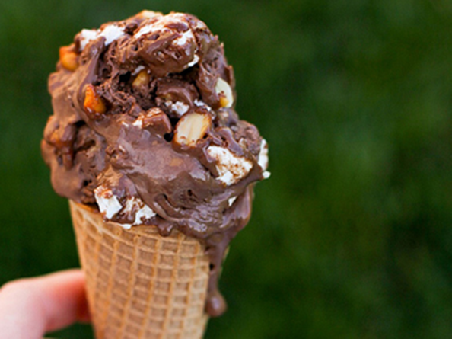
Ice Cream Flavology
Source:
Readers Digest,
Hidden Personality Traits Revealed Through Your Favorite Ice Cream Flavor
http://www.rd.com/slideshows/hidden-personality-traits-revealed-ice-cream/#ixzz3Idgf7kCf

Slide 2
The Research
Dr. Alan Hirsch (neurologist at Rush University, Chicago) uses various standardized psychiatric test results to make statistical correlations, explaining that the same part of the brain (the limbic lobe) is responsible for both personality traits and food preference. Interestingly, Hirsch says the taste for your favorite ice cream is set during childhood and tends to remain consistent throughout your life.

Slide 3
Types of Ice Cream
1
Vanilla
2
Strawberry
3
Chocolate

Slide 4
Types of Ice Cream
4
Mint Chocolate Chip
5
Rainbow Sherbet
4
Rocky Road

Slide 5
Types of Ice Cream
7
Coffee
8
Chocolate Chip

Slide 6
Vanilla
Vanilla lovers are impulsive.
Vanilla is one of the simplest of ice cream flavors, but its fans are actually likely to be colorful, impulsive, idealistic risk-takers who "rely more on intuition than logic," according to studies conducted by neurologist Dr. Alan Hirsch, founder of the Smell and Taste Treatment and Research Foundation. Vanilla lovers were also emotionally expressive and successful in close relationships.

Slide 7
Strawberry
Strawberry lovers are introverts.
In a study by Hirsch for Baskin Robbins, strawberry lovers were often tolerant, devoted, and introverted; in research conducted for Dreyer's/Edy's, he found fans of the berry flavor were also logical and thoughtful.

Slide 8
Chocolate
Chocolate lovers are flirtatious.
If you prefer a chocolate scoop, Hirsch determined you are likely to be flirtatious and seductive, and also lively, charming, dramatic, and gullible.

Slide 9
Mint Chocolate Chips
Mint chocolate chip lovers are argumentative.
According to Hirsch's study for Dreyer's/Edy's, which found this ice cream signified ambition, confidence, frugalness, and argumentativeness. "[They] aren't easily satisfied," said Hirsch about its fans. However, Hirsch predicts that mint chocolate chip lovers are compatible with one another.

Slide 10
Rainbow Sherbet
Rainbow sherbet lovers are pessimistic.
This flavor's bright colors and fruity taste is no match for the downbeat attitude of those who choose it as their favorite. "We found that people who prefer rainbow sherbet are more pessimistic than you would think," says Hirsch, who also found they're analytic and decisive.

Slide 11
Rocky Road
Rocky Road lovers are aggressive.
If this flavor-packed cone is your favorite, you're most likely aggressive and engaging, but a good listener, according to Hirsch's Baskin Robbins study. The Dreyer's/Edy's panel also determined that the goal-oriented Rocky Road lover is often successful, but sometimes aggressive behavior can "inadvertently hurt the feelings of those that surround him."

Slide 12
Coffee
Coffee lovers are dramatic.
If you're lively, dramatic, and approach life with "gusto," you're probably a fan of coffee ice cream. Hirsch's study for Dreyer's/Edy's says coffee ice cream fans are not concerned about the future and thrive on the "passion of the moment," needing constant stimulation in a romantic relationship.

Slide 13
Chocolate Chip
Chocolate chip lovers are generous.
If you choose classic chocolate chip, you're generous, competent, and a go-getter, according to Hirsch's survey for Baskin Robbins.

Slide 14
Ice Cream and Personality Traits

