Slide 1
Healthy Problem
Nama Kelompok 14 :
Meliana Sesilia Merry
Merchy Monika Putri Parura
Milka Yulianti
Nidya Natasya
Resna Br.Situmorang

Slide 2
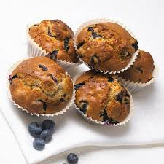
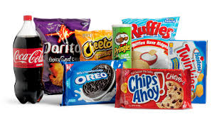
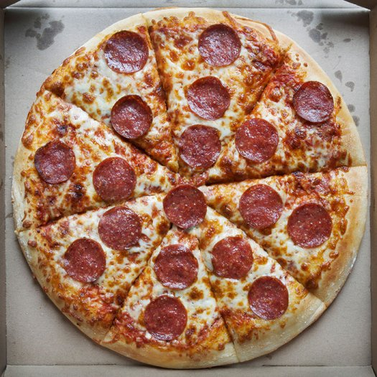
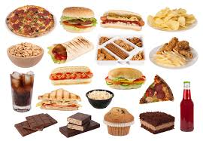
Eating Habits
“ JUNK FOOD”

Slide 3
PURPOSE

Slide 4
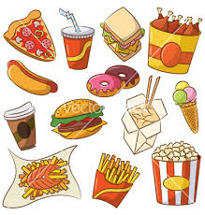
WHY??

Slide 5
Background

Slide 6
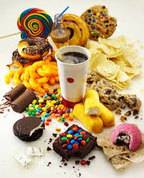
CREDIBILITY

Slide 7
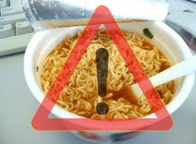
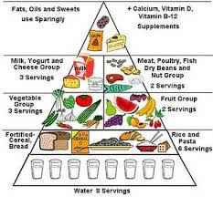
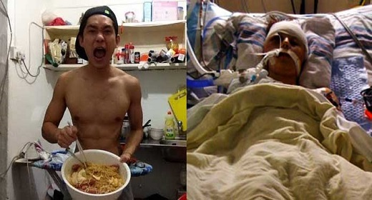

Slide 8
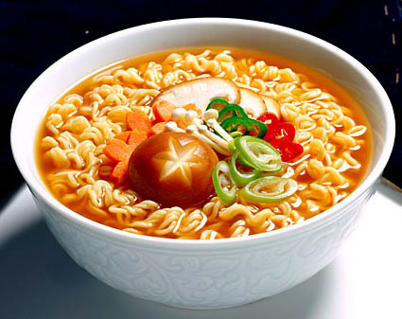
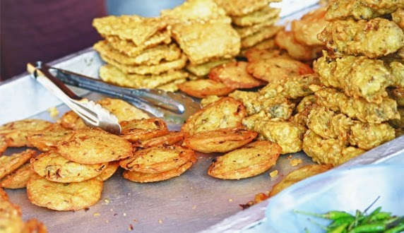
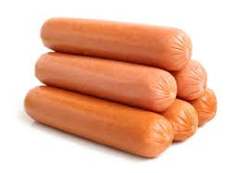
KIND OF JUNK FOOD IN INDONESIA

Slide 9
Health Problems happenS
Diabetes
Cancer
Fatigue
Liver damage
Obesity

Slide 10
How to change eating habits

Slide 11
Tips

Slide 12
Closing
Conclusion / summary
Junk food may only be consumed but do not continuosly up to become a habit because it affects our health.
Final message invitation
Eat a healthy diet regularly and eating less fast food. So it is better to prevent than cure, because a healthy start from ourselves.

Slide 13
Reference
www.kindjunkfood.com
www.articleeatinghabitsofjunkfood.com
www.problemhealthresultofjunkfood.com
www.tipshowtochangeeatinghabitsofjunkfood.com
www.contensofjunkfood.com
www.historyresultofnoodle.com
www.healthlifestyle.com

