Slide 1
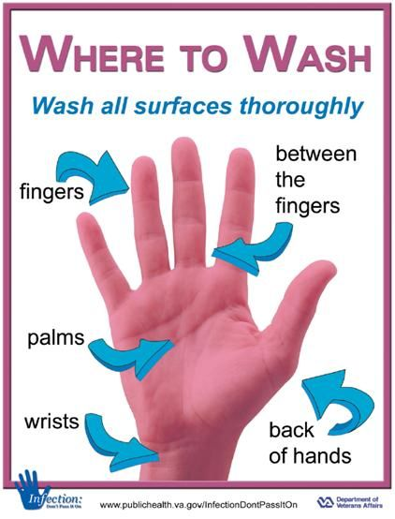
Hand washing for personal hygiene
https://www.who.int/gpsc/clean_hands_protection/en/

Slide 2
How do I wash my hands properly?
Washing your hands properly takes about as long as singing "Happy Birthday" twice, using the images below.

Slide 3
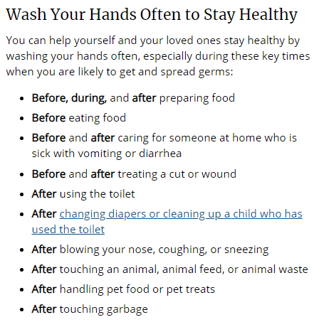
https://www.cdc.gov/handwashing/when-how-handwashing.html

Slide 5
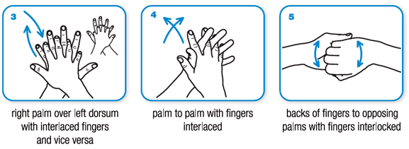

Slide 6
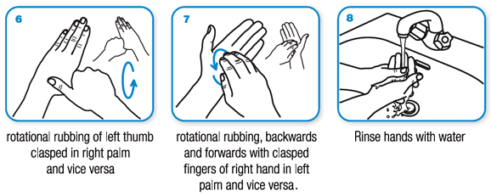

Slide 8
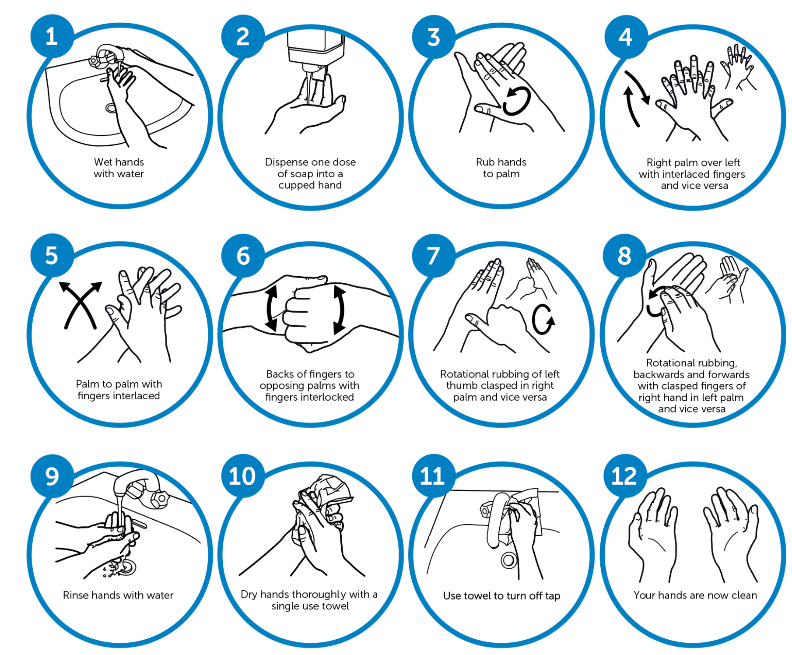
Hand Washing Steps

Slide 9
How to give instructions
For example:
Calculating the standard deviation
First, put the scores in order down the page.
Then, work out the mean.
Now calculate how much each deviates from the mean.
Next, square each of these deviations. Add them all up.
The next step is, divide by the number of scores.
Lastly find the square root.
This is the standard deviation.
First… / The first step is …/Firstly, …/ First of all … / To begin with ….
Secondly…./ The second step….
Then, ….
Next, … /the next step is …
When you have done that, …
Now, ….
Finally, …./ Lastly ….

Slide 10
Now,
Can you try giving instructions on how to wash hands properly, the WHO style?

Slide 11
https://www.kemkes.go.id/resources/download/info-terkini/Kesiapsiagaan%20RS%20dalam%20penangan%20COVID19/Daftar%20RS%20rujukan%20COVID-19.pdf

Slide 12
Discussion Questions
If you could describe COVID 19 in three words, what are they?
What are the three tips you can give to us to stay healthy?

