Slide 1
GREETINGS

Slide 2
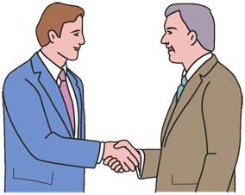
Greeting someone we know and often meet
Good morning (until around 11 am)
Good afternoon (after lunch – before 6 pm)
Good evening (after 6pm)
Hello, ____
Hi, ____

Slide 3
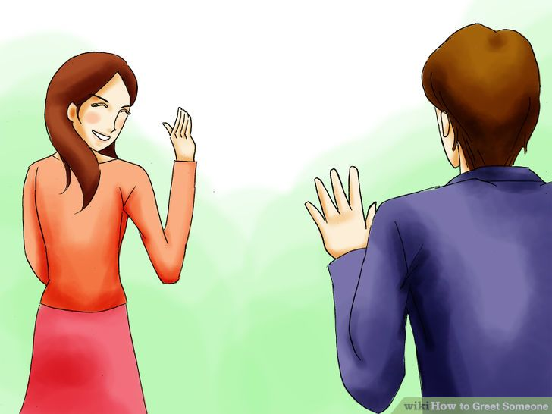
Greeting someone we know but rarely meet
How’re you?
How’s life?
Good to see you again
Nice to see you again.
I’m glad to see you.
I’m happy to see you.
I’m pleased to see you.

Slide 4
Greeting someone new
Hello.
Hi.
Good morning.
1
I’m David.
My name’s David.
4
2
Pleased to meet you too.
Nice to meet you too.
Happy to meet you too.
How do you do?
Pleased to meet you.
Nice to meet you.
Happy to meet you.
3

