Slide 1
e-General English
Course Introduction

Slide 2
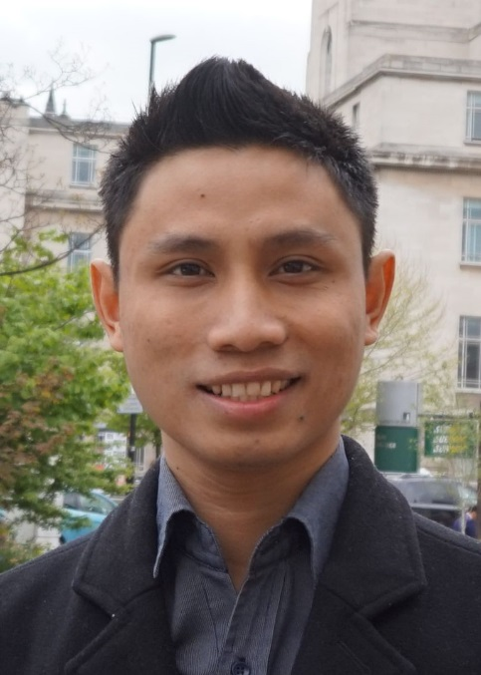
The General English Team
Sandra Sembel
(Coordinator)
sandra.sembel@uph.edu
Dwi Y. Nugroho
(Team member)
dwi.nugroho@uph.edu
Michael. R. Sihombing
(Team member)
michael.recard@uph.edu

Slide 3
GENERAL ENGLISH
Course Descriptions
What?
Roles
Learning Activities
Video Conference
Diagnostic Test
Class Policy
Participations
Assignments
Topics
Daily Assignments (KAT 1)
Discussion Forum
(KAT 2)
Presentations
(KAT 3)
Cheating and Plagiarism
Objectives
Evaluation

Slide 4
Setting a goal
You are never too old to set another goal or to dream a new dream. – C.S.Lewis

Slide 5
Summary 1: Course Descriptions
Course Descriptions
1.1. ENGLISH language COMMUNICATION skills in ACADEMIC CONTEXT.
1.1. What?
1.2. Objectives
1.2. understand and use intermediate level of English in academic context
1.3.Roles
1.3. Lecturer: Facilitator; Students: Active participants
1.4. Main topics: Main ideas, supporting details, vocabulary strategies, inference, paraphrasing, summarizing, synthesizing
1.4.Topics
1.5.Evaluation
1.5. KAT 1 (10%), KAT 2 (10%), KAT 3 (15%), Mid Test (25%), Final Test (40%)

Slide 6
Summary 2: Teaching and Learning Activities
Teaching & Learning Activities
Video Conferences
2.1. Session 1 and Session 9 (after mid-test)
Diagnostic Test
2.2. Multiple choice
Daily Assignments (KAT 1)
2.3. Ten (10) Assignments
Discussion Forum (KAT 2)
2.4. Six (6) Discussion forums
Presentations (KAT 3)
2.5. Two (2) Speaking tasks

Slide 7
Learning is not a spectator sport. – D. Blocher
Message to remember!
If you want to master English, get involved and practice as much as possible.

Slide 8
Summary 3
Class Policy
Participations
3.1. Video conferences, discussion forums, daily assignments, speaking tasks, quizzes and tests
Assignments
3.2. KAT 1 (Daily assignments), KAT 2 (Discussion forums), KAT 3 (Speaking assignments)
Cheating and Plagiarism
3.3. No Cheating, No Plagiarism – Failed the course

Slide 9
Thank you and God bless you!
For the Lord gives wisdom; from His mouth comes knowledge and understanding. (Proverbs 2: 6)

