Slide 1
EFFECTIVE LEARNING
SMALL GROUP 12

Slide 2


Slide 3
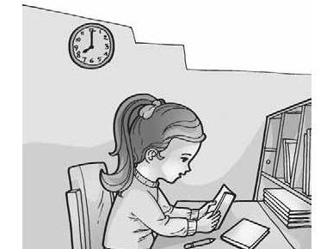
Arrange your daily schedule (choose the right time)

Slide 4

Learn in a comfortable place

Slide 5

Understand the material and do not memorize

Slide 6

Summarizing Lessons

Slide 7

Learn to mind map

Slide 8
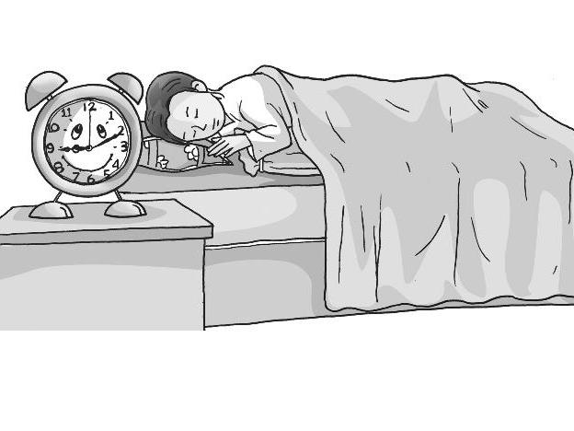
Learn the routine (discipline) and not too long, interspersed with breaks

Slide 9
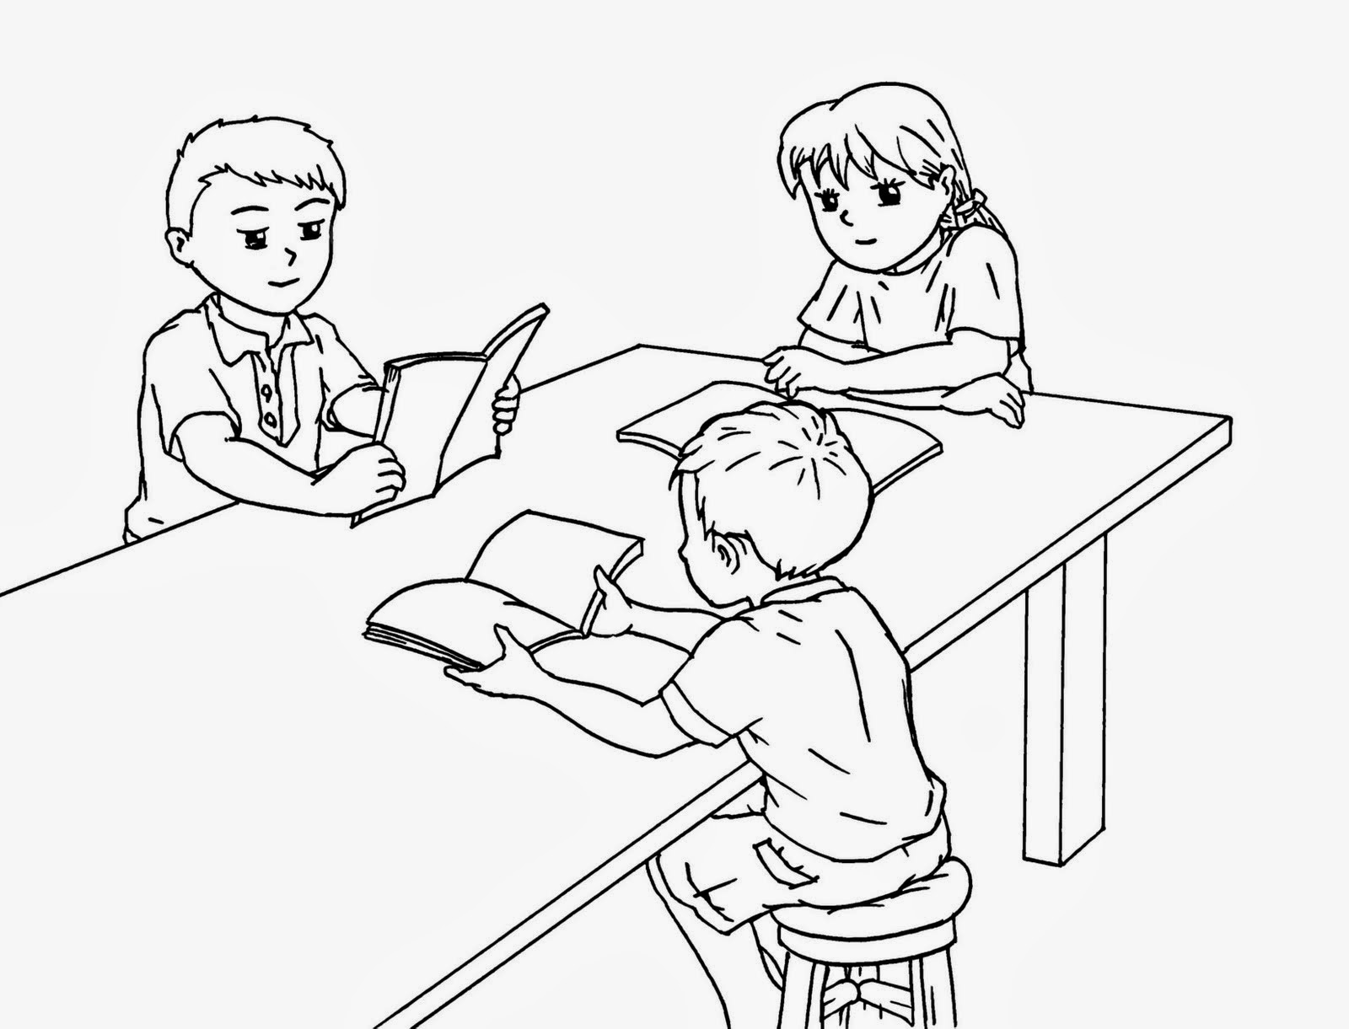
Learning while discussion (with friends)

Slide 10

Not Using SKS (racing system overnight)

Slide 11

More reading

Slide 12

EFFECTIVE LEARN

Slide 13
REFERENCE
Suryosubroto. 1997. Proses Belajar-Mengajar di Sekolah. Jakarta: Rineka Cipta.
Suyanto. 2000. Refleksi dan Reformasi Pendidikan di Indonesia Memasuki Milenium III. Yogyakarta: Adicita.
William, LV. 1983. Teaching for The Two Sided. Englewood Cliffs New Jersey: Prentice Hall.

