Slide 1
Feelings and emotions

Slide 2
How are you feeling today?
I have to take a plane to go out of town.
It’s my first trip with an air plane.
So, I feel ________

Slide 3
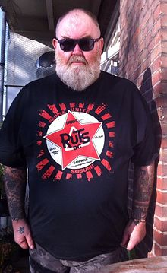
How are you feeling today?
I met Big John this morning.
He was wearing a pink t-shirt
So, I felt ________ to see him in pink t-shirt.

Slide 4
How are you feeling today?
Yesterday, I was introduced to a girl. She is so beautiful. She smiled at me.
So, I feel ________

Slide 5
How are you feeling today?
I just received news from my mother this morning. She said my good friend, Brian passed away because of a motorcycle accident. He wasn’t wearing helmet at that time.
So, I feel ________

Slide 6
How are you feeling today?
I watched football game on TV last night until after midnight.
So, today, I feel ________

Slide 7
How are you feeling today?
Jim promised to meet me to go to the gym at 4 pm. Now, it’s 5 pm and he is not here yet.
So, I feel ________

Slide 8
How are you feeling today?
I have a headache. I sneeze all time. Perhaps because yesterday I was out in the rain when I went home from campus.
So, I feel ________.
I need a blanket.

Slide 9
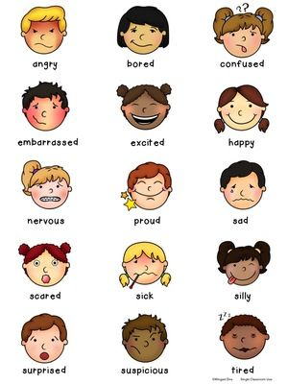
Other feelings and emotions

