Slide 1
English for Nursing
Overview

Slide 2
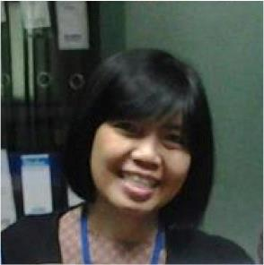
Sandra sembel
CLASS COORDINATOR
Status: A proud mom of a teenage boy
Major: English Education, Economics, Management

Slide 3
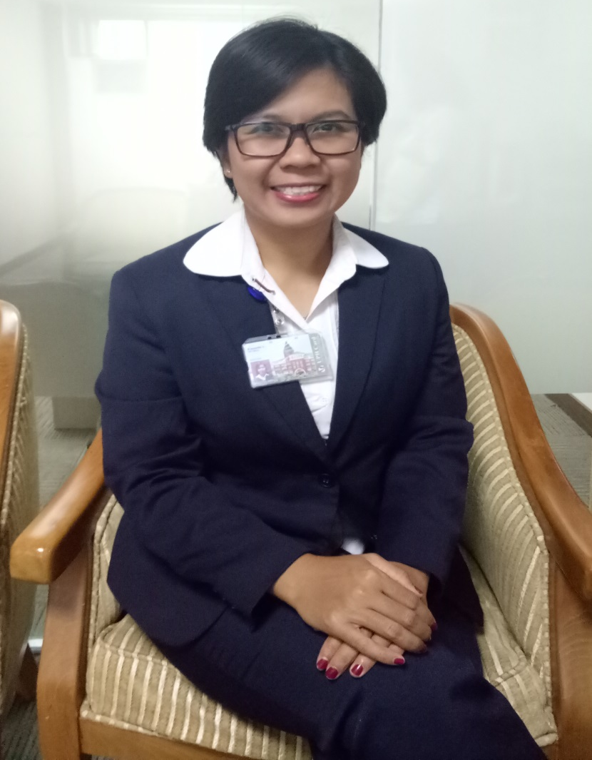
Kinanthi lebdawicaksaputri
Status: Single, in relationship
Education: Sarjana Keperawatan, NERS - FON UPH

Slide 4
COURSE DESCRIPTION
This course is for student nurses who have early operational ability to communicate using simple language (who are beginning to use English to express themselves) and wish to improve their mastery and confidence to operational level in general nursing context.

Slide 5
Goals and Objectives
Communicating at basic operational level about the following topics:
Introduce themselves to fellow medical professionals and to patients
Ask for and give information
Understand and give instructions
Understand and explain a process
Ask for and give advice
Ask for and give opinions

Slide 6
Topics
Week1 Course Introduction: Course outline and Class Policy
Week 2 This is our Hospital
Week 3 I am your nurse
Week 4 Here is how to do it

Slide 7
topics
Week 5 Wound Care
Week 6 Handover
Week 7 Quiz 1
Week 8 Mid-Test

Slide 8
topics
Week 9 Drug Administration
Week 10 Pre-operative Checks
Week 11 Post-operative Checks
Week 12 Handling Complaints

Slide 9
topics
Week 13 Death and Dying: Breaking bad news
Week 14 Discharge Planning
Week 15 Quiz 1I
Week 16 Final Test (Video Project – Small Group)

Slide 10
Evaluation
No | Indicators | Weight | Learning Objectives | Tasks
1 | KAT 1 | 10% | LO A1 - A6 | Class Assignments
2 | KAT 2 | 20% | LO A1 – A3 LO A4 - A6 | Quiz 1 Quiz 2
3 | Mid-Test | 30% | LO A1 - A3 | Speaking Test
4 | Final Test | 40% | LO A1 - A6 | Video Project

Slide 11
LEARNING PLAN
Complete and Submit pre-class
Complete each activity assigned on that day
Opening
Learning
Closing
Complete and Submit post-class activities

Slide 12
CLASS POLICY
Attendance
On-time
Absence
Notification(Dorm Parent)
Submit activities and assignments
Learning
Full participation
Exams and Assignments
Tolerance(15')
100%
Questions
Pre and Post
Honesty
On-time submission
References

Slide 13
Class leaders
President
Announcements and Tasks Coordination – Class level
Choosing students responsible for opening and closing prayers
Vice Presidents: Small Group Leaders
Announcements and Tasks Coordination – Small Group Level
Attendance

Slide 14
Additional Info
If you have any questions feel free to come and approach the lecturers in FoN office, 4th Floor within working days and only from 7 AM – 4 PM.
Thank you
English for Nursing Team

