Slide 1
Hari 3: Mendisain silabus untuk Blended Learning Courses
Template

Slide 2
Elements of a blended learning syllabus
Course Descriptions
Course Goals
Course materials
Course Schedule
Course Policy and Expectations
Assignment and Exams Instructions + Rubrics
Netiquettes
Technical support
Instructors and communication policy

Slide 3
Course Introduction

Slide 4
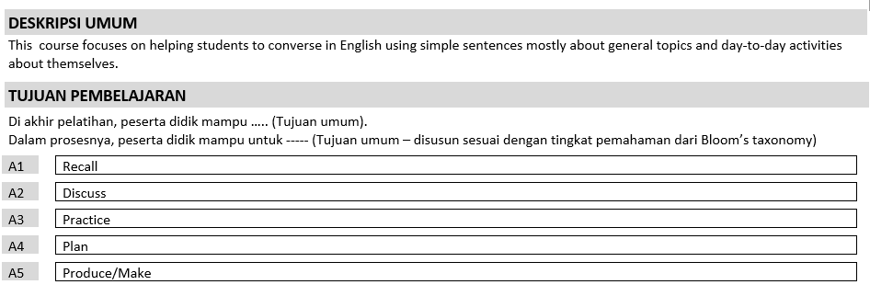
Course Descriptions

Slide 5
Strategi pembelajaran

Slide 6
Class Policy

Slide 7
References

Slide 8
Penilaian (Evaluasi)

Slide 9
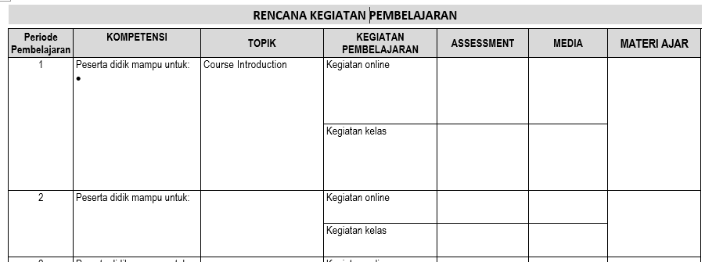
Rencana Kegiatan Pembelajaran

Slide 10
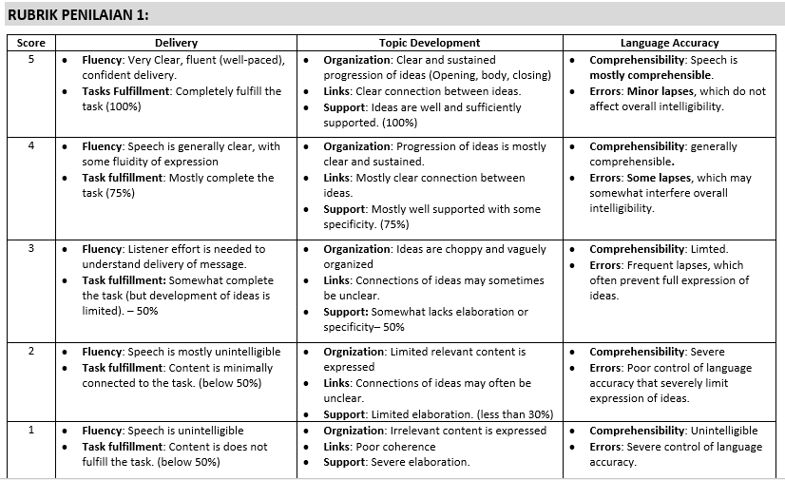
Rubrik Penilaian

Slide 11
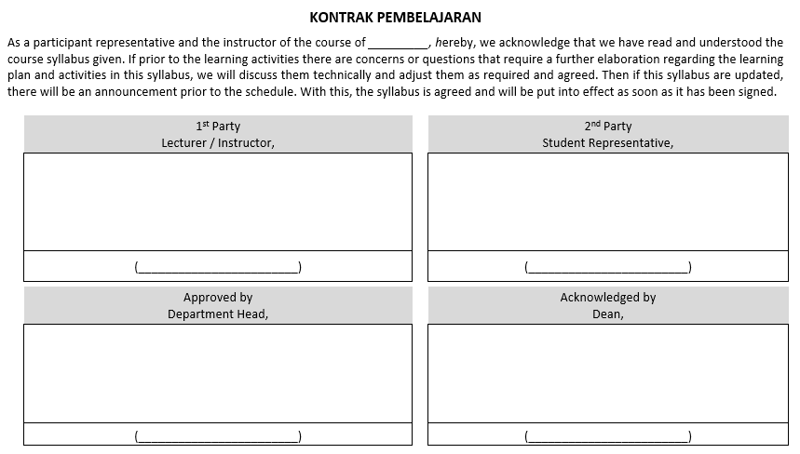
Kontrak Pembelajaran

