Slide 1
Capacity Building: Pengembangan Paket Materi Belajar oleh Guru untuk Guru
Di Tuban dan Bojonegoro, Jawa Timur

Slide 2
Sandra Sembel
Education consultant
Curriculum designer
Facilitator for teacher education
Lecturer
Instructional
Materials Writer
Workshop faciliatators:
Presentation skills
Entrepreneurships
Teacher professional dev’t
Personal leadership
E-learning consultant
Sandrasembel.weebly.com

Slide 3
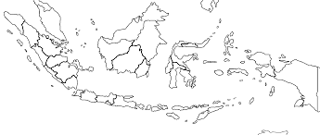
PKM yang pernah kami kerjakan
Bermitra untuk membangun bangsa
Learningpartnerships.weebly.com

Slide 4
Mengapa Program Pembuatan Buku ini Penting?
Jumlah terbitan buku di Indonesia per tahun? (Data 2013, IKAPI)
1
66.000
44.000
18.000
5.000
Di dunia: 2,2 juta
(2015, UNESCO)
China 440,000
Vietnam 24,589

Slide 5
Penerbitan Buku Per negara
Asean Book Publishers, Association, 2010 in Wikipedia

Slide 6
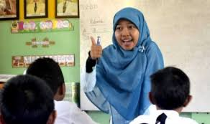
Buku Pelajaran
33.199.557 eksemplar buku terjual di Indonesia sepanjang 2013 (data TB Gramedia).
Nuansa Lokal?
Buku Import?
Ditulis oleh guru?
Buku Pendidikan (Pelajaran) hanya 13 persen
2

Slide 7
Deskripsi Program
Tujuan
Membimbing Buku Pegangan guru SMP dan SMA
Peserta
Guru SMP dan SMA (30 guru)
Bojonegoro dan Tuban
Pelaksanaan
Analaysis
Design
Development
(Implementation)
(Evaluation)
Meluncurkan buku pelajaran

Slide 8
Pelaksanaan
Analysis
FGD
Class observation
Interviews (guru, siswa, Dinas Pendidikan)
Design
Kurikulum
Syllabus
Buku
--Goals
--Topics
– Scope and Sequence
--Unit outline
Dev’t
Materials writing, editing and revising
Implement
Micro-teaching
Panel Discussion
Poster Session
Book launching
Scoping visit
Design Docment
Third Draft
Soft launching
Evaluation

Slide 9
HASIL
1. Genre-Based Approach
BKOF
Joint Constr
2. Materi Instruksional
Nuansa lokal
Worksheets
Indep. Constr
Steps
Look, learn, Practice, Apply, Beyond
3. Pelatihan
Curiculum Review & content design
First draft writing
Editing and revising
Micro-teaching
4. Buku
Buku Pegangan Guru
SMP
SMA
5. Dampak Positif
Writing habit
Publishiing experiience
Teaching Competence
Local culture

Slide 11
KEBERLANJUTAN
Sense of belonging
Sharing di MGMP
Menerbitkan sendiri

Slide 12
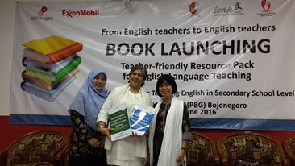
Penutup

Slide 13
Develop their teaching skills
If you want to change a nation, develop the teachers.
Grow their teaching hearts
Inspire them to write and publish
God bless us all!

Slide 14
REFERENSI
Agustien, HIR, 2006, “Genre Based Approach and the 2004 english Curriculum”,
Makalah yang dipresentasikan pada Plenary session di UPI National Seminar, Universitas Negeri Semarang, Semarang, 27 Februari.
Feez, S. dan H. Joyce. 2002. Text-Based Syllabus Design. Sydney: NCELTR, Macquarie University
Depdiknas. 2005. Peraturan Pemerintah Republik Indonesia Nomor 19 Tahun 2005 tentang Standar Nasional Pendidikan. Jakarta: Depdiknas Republik Indonesia.
Djuwariah, Ahmad, Understanding the 2013 Curriculum of English Teaching through the Teachers’ and Policymakers’ Perspectives, International Journal of Enhanced Research in Educational Development (IJERED), ISSN: 2320-8708 Vol. 2, Issue 4, July-August, 2014, pp: (6-15), Impact Factor: 1.125, Available online at: www.erpublications.com
Hammond, J, A. Burns, H. Joyce, D. Brosnan, L. Gerot, 1992, English for Special Purposes: A handbook for teachers of adult literacy. Sydney: NCELTR, Macquarie University.
Lana, 2009, Genre Based Approach. Retrieved on October 7, 2016, from http://lana-cometorich.blogspot.co.id/2009/06/genre-based-approach.html

Slide 15
Jika ingin datang ke danau melihat angsa, Tak perlulah membawa baskom. Bila kita diijinkan bersama membangun bangsa hubungi kami di ssembel@gmail.com
sandrasembel.weebly.com

