Slide 1
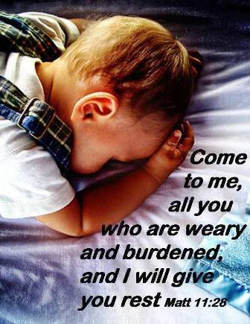

Slide 2
Attendance
Communication
Assignments
Academic code of ethics
Exams
Dress code
Academic Regulations Team:
Lia, Christine, Sandra

Slide 3
Day and Night

Slide 4
Seasons

Slide 5
Traffic Signs

Slide 6
Why Rules/Policy is important?

Slide 7
The Importance of Rules/Discipline
For the moment all discipline seems painful rather than pleasant, but later it yields the peaceful fruit of righteousness to those who have been trained by it. (Hebrews 11: 12)

Slide 8
Rules/Policy
Guidelines
Comfort
Planning
Security

Slide 9
Attendance (Presence in class)
In-time: Come before the class starts
Perfect attendance: Attendance100%.
Signing: Attendance list, Lab attendance list

Slide 10
Communication (Komunikasi)
Express Opinions: Express in good manner
Ask questions: Wait for your turn
Respect: Respect each other
Listen skills: Active listening
Opinions
Questions
Respect
Listening skills

Slide 11
Assignments (Tugas)
Complete: with cover sheet
Deadlines (15:00) – 5%
Originality: Do it yourself
Critical Thinking (analysis, compare and contrast, no cut and paste)
Clear Identity: Name and NIM
Complete
Deadline
Originality
Critical thinking
Identity

Slide 12
Academic Code of Ethics
Active Participation: Listen, speak, do activities
Positive attitude: Respect and positive contribution
Maintain order: Maintain order and cleanliness
Originality: No plagiarism
Active participation
Positive attitude
Maintain order
Originality

Slide 13
Exam Rules
Good Preparation: optimum preparation
Honesty: No cheating
Time management: Time allocation.
Instructions: Understand instructions
Completeness: Do all parts
Handwriting: Write clearly
Identity: Name and NIM

Slide 14
Dress Code
Casual and proper:
Clothing
Shoes
Uniforms:
Official events
UPH
Casual and proper
Uniform

Slide 15
Matthew 6: 33
But seek first his kingdom and his righteousness, and all these things will be given to you as well.

Slide 16
Thank you!

