Slide 1
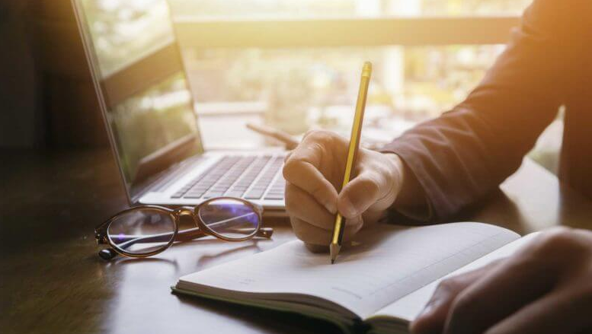
Guided-Practice
Let’s use the context to figure out the meaning of the underlined word.
What Clues?

Slide 2
1. When Harry's boss went on a maternity leave, Harry became the interim department head. He handled employee payroll for the three months she was away. Interim most likely means….
Interim most likely means….….
Temporary
New
Professional

Slide 3
2. The heavy rain made it difficult to see. Jill meant to turn right on King Street, but she inadvertently turned onto Cedar Street instead.
Inadvertently most likely means...
Carefully
Deliberately
Unintentionally

Slide 4
3. Stephen received a written reprimand from his supervisor when he showed up late the third time. If his lateness continues, he will be asked to meet with a human resources representative.
Reprimand most likely means…
Criticism
Apology
Insult

Slide 5
4. From experience Ellen knows that the more she studies, the better she does in school. Her marks on exams attest to many hours of hard work. Attest most likely means …..
Give proof of
Honor
Argue

Slide 6
5. At the end of each workday, Daniel arranged his papers into neat piles, dusted his computer, and tucked his chair under the desk. He was equally meticulous at home.
Meticulous most likely means……
General
Careful about details
Stern

Slide 7
6. The lawyers were poorly prepared. The defendant was late. The jurors talked during the trial. The judge declared the case to be a travesty of justice. Travesty most likely means…..
Mockery
1
Example
2
Emblem
3

Slide 8
7. Searching students' lockers without permission is considered by some to be an infringement of students' rights. Infringement most likely means…
Assertion
Violation
Example

Slide 9
8. Bill is always tardy for class. Yesterday, for example, he showed up 15 minutes after class had started.
Late
Ready
On time

Slide 10
9. George has the flu. Usually, he's energetic, but today he's lethargic.
Unhappy
Sluggish
Sick

Slide 11
10. Helen tended to cry when she was upset about work or family, but in the face of danger, she was stoic.
Generous
Frightened
Not Showing pain or emotion

