Slide 1
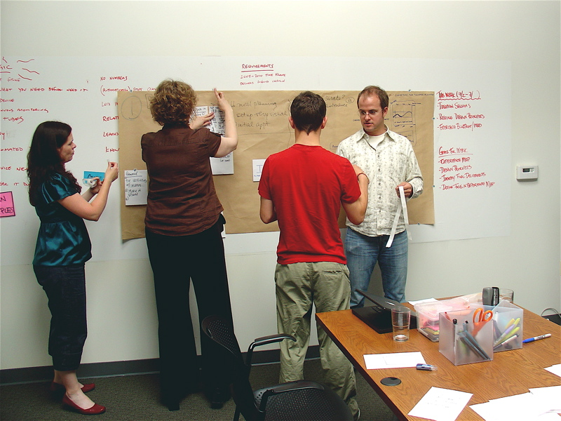
The essentials of Learning, E-learning and ISD
ssembel@gmail.com

Slide 2
Learning

Slide 3
The essentials of learning, e-learning and ISD
L E A R N I N G
Problem
Goal
Face-to-face
E-learning
INSTRUCTIONAL DESIGN STRATEGIES
Motivation
Ease
Interesting
L E A R N I N G G A I N
CHANGE
Solution
Useful
Knowledge
Skills
Attitude

Slide 4
Key Questions
Who are the learners?
How do I help them to do it?
How do I know that they have learned what they need to?
What do they need to learn?

Slide 5
Key Answers
Learner profile
Learning Activities and Experiences
Learning Evaluation
Learning Goals and Objectives

Slide 6
Learner Profile
Demographic
Age
Gender
Learning
Problems
Needs
Job
Level
Education
Goals
Styles
Descriptions

Slide 7
Learning goals and objectives
Focus on learning NEEDS
Have CLEAR learning outcomes
Knowledge
Can be clearly demonstrated, measured
Skills
Attitude

Slide 8
Learning Activities and Experiences
Prepare them for the activities
Guide them throughout the activities
Monitor their progress
Give them the means to explore the activities
Give them the opportunity to explore beyond the activities

Slide 9
Learning Evaluation
Give them sufficient time to demonstrate what they have learned
Give them the tools to demonstrate what they have learned
Give them feedback for improvement

Slide 10
Thank you and have a great weekend!

