Slide 1
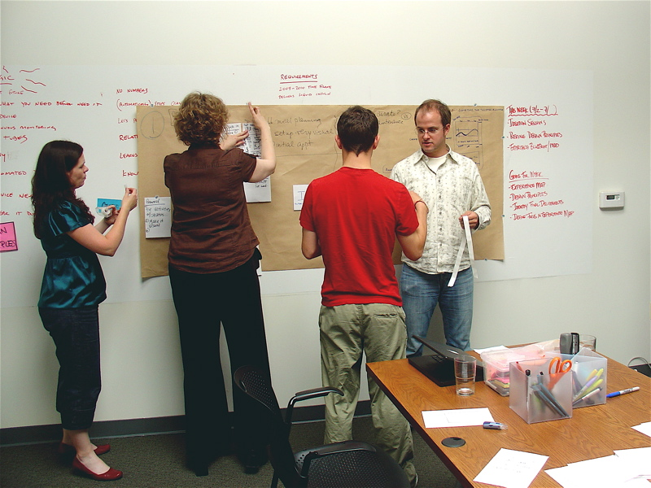
Three Key Considerations in Curriculum and Materials Development
ssembel@gmail.com

Slide 2
Three Key Questions
What do I want my learners to do?
How do I help them to do it?
How do I know that they have learned what I want them to do?

Slide 3
Three Key Answers
Learning Goals and Objectives
Learning Activities and Experiences
Learning Evaluation

Slide 4
Learning goals and objectives
Focus on COMMUNICATION needs
Have CLEAR learning outcomes
How language can help them operate in their daily lives
Can be clearly demonstrated

Slide 5
Learning Activities and Experiences
Prepare them for the activities
Guide them throughout the activities
Monitor their progress
Give them the means to explore the activities
Give them the opportunity to explore beyond the activities

Slide 6
Learning Evaluation
Give them sufficient time to demonstrate what they have learned
Give them the tools to demonstrate what they have learned
Give them feedback for improvement

Slide 7
Thank you and have a great weekend!

