Slide 1
Look at the picture

Slide 2
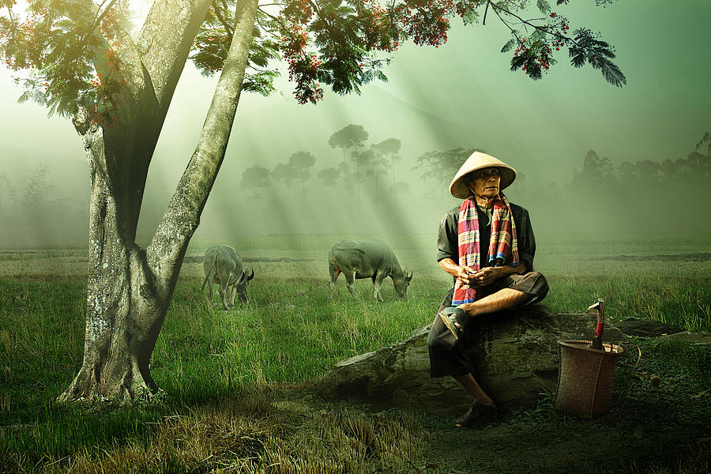
GROUP 1
Give identity to this person:
What is his name?
How old is he?
Where does he live?
What does he do for a living? (What is his job?)
How long has he been doing his work?
Tell us about his family? (Wife, children)

Slide 3
Group 2
What is his name?
What is his job?
What did he do this morning before coming to this place? (Two or three activities)
What will he do after this? (Two or three activities)

Slide 4
Group 3
Where is he now?
Think of several reasons why he is sitting there? (Give short explanation for each reason)

Slide 5
Group 4
What is his problem?
What are your suggested solutions to his problem?

Slide 6
Group 5
How do you plant a fruit tree?
What are the steps of planting a fruit tree?

