Slide 1
Instructional Design Models
Source: http://info.shiftelearning.com/blog/top-instructional-design-models-explained

Slide 2
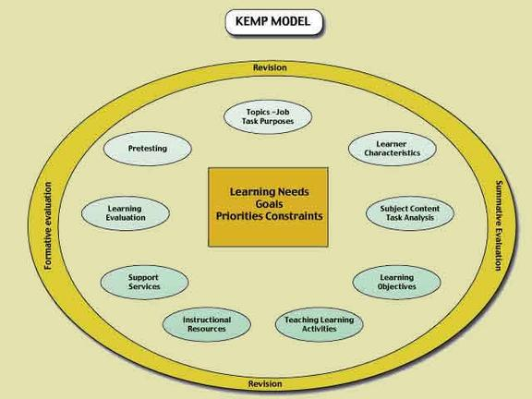

Slide 3
Kemp’s Design: 9 elements
Identify instructional problems, and specify goals for designing an instructional program.
Examine learner characteristics that should receive attention during planning.
Identify subject content, and analyze task components related to stated goals and purposes.
State instructional objectives for the learner.
Sequence content within each instructional unit for logical learning.
Design instructional strategies so that each learner can master the objectives.
Plan the instructional message and delivery.
Develop evaluation instruments to assess objectives.
Select resources to support instruction and learning activities.

Slide 4
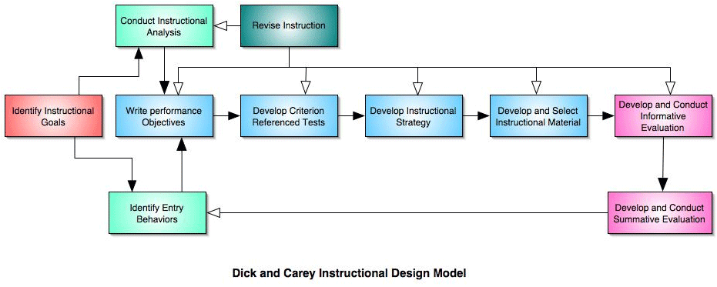

Slide 5
Stage 1: Identify Instructional Goals
Stage 2. Conduct Instructional Analysis
Stage 3. Identify Entry Behaviors and Learner Characteristics
Stage 4: Write Performance Objectives
Stage 5. Develop Criterion-Referenced Test Items
Stage 6. Develop Instructional Strategy
Stage 7: Develop and Select Instructional Materials
Stage 8: Develop and Conduct Formative Evaluation
Stage 9: Develop and Conduct Summative Evaluation

Slide 7
ADDIE
Step #1 Analysis — Why is the training needed?
Step #2 Design —Select the instructional strategy, objectives, media and delivery methods.
Step #3 Development — Develop the course materials.
Step #4 Implementation — Implement, roll-out, deliver to the learners, and monitor its impact.
Step # 5 Evaluation — Evaluate the impact based on learner feedback, surveys, and even analytics.

