Slide 1
Academic Listening Track 5, page 5

Slide 2
Car Alarm
Product name?
Problem?
Effects of the product?

Slide 3
Car Alarm
Product name?
Thief buster
Problem?
Car is stolen
Effects of the product?
Alarm rings
Engine stops

Slide 4
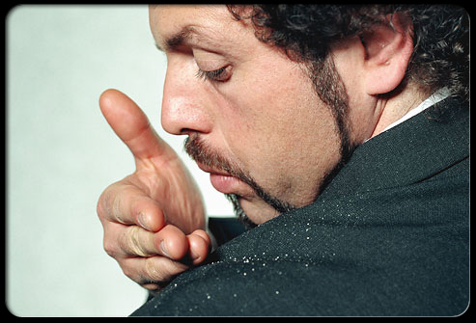
Dandruff
Product name? Rinse Away
Problem? Dandruff flakes, embarrassed
Effects of the product? Take care of the toughest dandruff, feel the confidence, Cure for dandruff

Slide 5
Listen again!
How are the two ads similar? They both present …
Embarrassing situations
Frightening situations
Negative situations
Humorous situations

Slide 6
2. What two products are advertised in these ads? (Choose two)
Cars
A security system
Jackets
Shampoo
Cornflakes

Slide 7
First Ad
3. What technique does the ad use to sell the product?
It illustrates a personal story.
It compares different car alarms.
It explains a two-step process.
It describes its many features.

Slide 8
First Ad
4. Why does the announcer say, “So, why put your car at risk any longer? Get a Thief Buster Security System today.”?
To ask listeners to answer the question
To introduce a solution to the problem
To invite listeners to discuss the topic
To make listeners feel that they don’t know anything.

Slide 9
Second Ad
5. What is the speaker’s attitude toward his problem?
Angry
Frustrated
Embarrassed
Confused

Slide 10
Second Ad
6. What does Rinse Away stop?
Ichy shoulders
White hair
Dandruff
Headaches

Slide 11
Answers

Slide 12
Listen again!
How are the two ads similar? They both present …
Embarrassing situations
Frightening situations
Negative situations
Humorous situations

Slide 13
2. What two products are advertised in these ads? (Choose two)
Cars
A security system
Jackets
Shampoo
Cornflakes

Slide 14
First Ad
3. What technique does the ad use to sell the product?
It illustrates a personal story.
It compares different car alarms
It explains a two-step process.
It describes its many features.

Slide 15
First Ad
4. Why does the announcer say, “So, why put your car at risk any longer? Get a Thief Buster Security System today.”?
To ask listeners to answer the question
To introduce a solution to the problem
To invite listeners to discuss the topic
To make listeners feel that they don’t know anything.

Slide 16
Second Ad
5. What is the speaker’s attitude toward his problem?
Angry
Frustrated
Embarrassed
Confused

Slide 17
Second Ad
6. What does Rinse Away stop?
Itchy shoulders
White hair
Dandruff
Headaches

