Slide 1
Listening, Unit 1, page 3 Campus Conversation

Slide 2
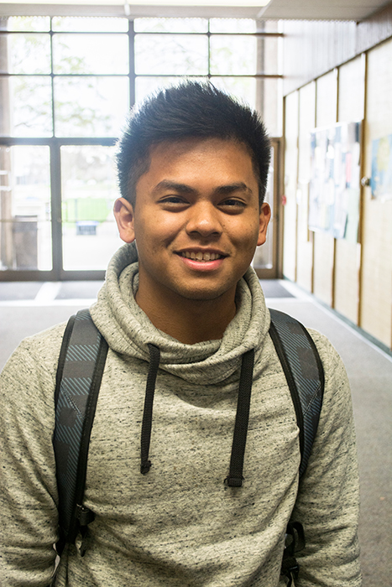
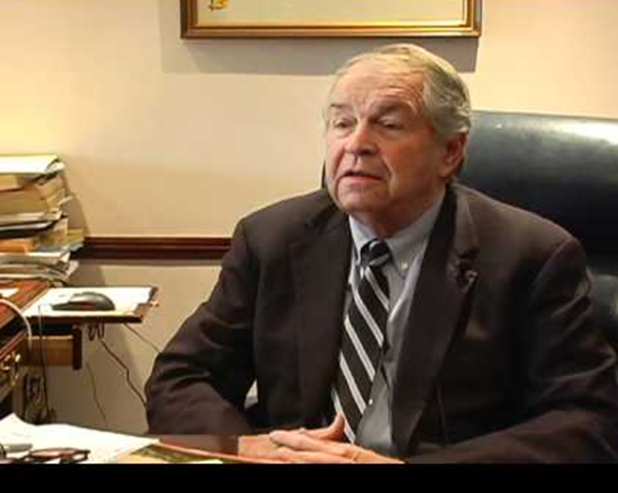
Campus Conversation
Eric
Prof. Burton

Slide 3
Campus Conversation, page 3
Fine prints
Results can vary
Infomercial
Held liable
Caveat emptor (let the buyer beware)
False advertising
Sue
Ab machine
Trust
False claims
Lecture
Exaggerate
Listen to the conversation and number the word/s according to the order of happening.
Prof. Burton
Eric
Appointment at 10.30

Slide 4
Campus Conversation, page 3
Lecture
Infomercial
Trust
False claims
Held liable
False advertising
Sue
Ab machine
Exaggerate
Caveat emptor (let the buyer beware)
Fine prints
Results can vary

Slide 5
Comprehension questions
What is the conversation mainly about?
Why does the student go to see his professor?
Why is the student’s friend unhappy with her ab machine?
What does the professor mean, when he says, “Well, as far as I know, companies can’t make false claims about their products.”?
What is the student’s attitude when he says, “Well, that may be so, but in my experience, the product isn’t always what it appears to be.”?
The student said that the reality doesn’t match the claim.
She didn’t get the result she had expected
Ask a question about the previous lecture
Infomercial
The professor wanted to highlight what companies should normally do.

Slide 6
Best Infomercials
Snuggie
https://www.youtube.com/watch?v=2xZp-GLMMJ0
Lantern
https://www.youtube.com/watch?v=l9QXPCSQ7OQ

