Slide 1
Opening Prayer

Slide 2
Our Daily Bread

Slide 3
I am your nurse
(Introducing ourselves to patients)

Slide 4
Session A: Video Watching

Slide 5
Answers to Video Watching in Session A
1. Which one is the correct way to greet an elderly patient for the first time?
Good morning, Tim.
Good morning, Mr. Timothy Brown.
Good morning, sweetie.

Slide 6
Answers to Video Watching in Session A
1. Which one is the correct way to greet an elderly patient for the first time?
Good morning, Tim.
Good morning, Mr. Timothy Brown.
Good morning, sweetie.

Slide 7
Answers to Video Watching in Session A
2. Which one is the most appropriate way to introduce yourself as a nurse or carer to an elderly patient?
I’m Samantha, your nurse today.
I’m Sam, your nurse today.
I’m Mrs. Brown, your nurse today.

Slide 8
Answers to Video Watching in Session A
2. Which one is the most appropriate way to introduce yourself as a nurse or carer to an elderly patient?
I’m Samantha, your nurse today.
I’m Sam, your nurse today.
I’m Mrs. Brown, your nurse today.

Slide 9
Answers to Video Watching in Session A
3. Why do carers or nurses in a nursing home or hospital use a badge?
(A) To help patients remember the nurse’s or carer’s name
(B) To help the nurse or carer remember their own names
(C) To make them feel more confident wearing the badge

Slide 10
Answers to Video Watching in Session A
3. Why do carers or nurses in a nursing home or hospital use a badge?
(A) To help patients remember the nurse’s or carer’s name
(B) To help the nurse or carer remember their own names
(C) To make them feel more confident wearing the badge

Slide 11
Answers to Video Watching in Session A
4. Which expression do we use to ask the patient’s health?
How are you?
How are you feeling today?
How do you do?

Slide 12
Answers to Video Watching in Session A
4. Which expression do we use to ask the patient’s health?
How are you?
How are you feeling today?
How do you do?

Slide 13
Answers to Video Watching in Session A
5. Is it okay to use a term of endearment (e.g. dear, sweetie, sweetheart) to address a patient?
Some elderly don’t like carers or nurses to use it.
Some elderly don’t know what it is.
Some elderly don’t care what it is.

Slide 14
Answers to Video Watching in Session A
5. Is it okay to use a term of endearment (e.g. dear, sweetie, sweetheart) to address a patient?
Some elderly don’t like carers or nurses to use it.
Some elderly don’t know what it is.
Some elderly don’t care what it is.

Slide 15
ICE BREAKING

Slide 16
Interview a friend
Questions | You | Your friend
Where do you come from?
2. What is Favorite nursing subject?
3. What is favorite non-nursing subject?

Slide 17
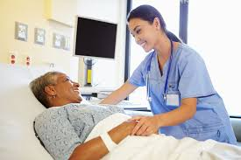
Model Dialog

Slide 18
Nurse | : | Good morning, Mrs. Wilma Blaine. I am Nurse Shally Brown but you can just call me Shally. I’ll be looking after you this morning.
Patient | : | Oh, hello Shally. Just call me Wilma, please.
Nurse | : | Okay, Wilma. How are you feeling today, Ma’am?
Patient | : | Not so good, actually. I couldn’t sleep well last night because my back is really aching.
Nurse Patient Nurse | : : : | I see. Your back is aching? Which part? This part of my back. Okay. Let me do an observation on you now. Would that be alright?
Patient | : | Sure, go ahead.
Nurse | : | All right. After the observation I’ll see if I can do anything about your back pain.
 |  | (after doing the observation)
Nurse | : | There you go, Wilma. Are you feeling much better, now?
Patient | : | Much better, thank you, Shally.
Nurse | : | Good. I’ll report this to the doctor too.
Patient | : | Thank you.
Nurse | : | Well, nice talking to you today, Wilma. I need to go now to see other patients. If you need me, just press this bell and I will come as quickly as I can.
Patient | : | Okay. Thanks.

Slide 19
Answer the questions about the dialog
What time of day is it? (Morning, afternoon, evening). How do you greet people in the morning? Afternoon? Evening?
What is the name of the nurse?
What does she prefer to be called?
What is the name of the patient?
What does she prefer to be called?
What seems to be the problem with the patient?
What will the nurse do about the problem?
What can we do about a back pain?
What should the patient do if she needs the nurse?
What will Nurse Shally do next?

Slide 20
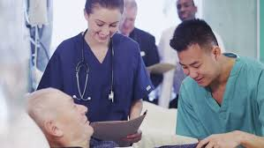
Language Expressions: Introducing ourselves

Slide 21
Introducing ourselves
What should a nurse do when she or he introduces herself/himself to a patient for the first time?
Greet the patient (Good morning)
Say the profession (Nurse)
Say the complete name (Shally Brown)
Say the preferred name (Shally)
Say the purpose of her visiting the patient (I’ll be looking after you this afternoon)
Good morning, Mrs. Wilma Blaine. I am Nurse Shally Brown but you can just call me Shally. I’ll be looking after you this morning.

Slide 22
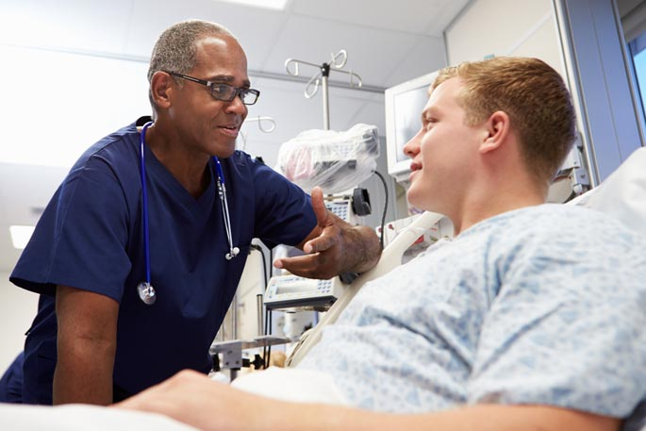
Introducing ourselves: Try it!
Now, please try it with the person sitting next to you!
Greet the patient
Say the profession
Say the complete name
Say the preferred name
Say the purpose of her visiting the patient

Slide 23
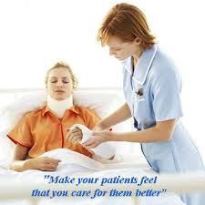
Dealing with pain
What does the nurse say to ask how the patient is feeling?
(How are you feeling today, ma’am?)
What does the nurse say to respond to the pain the patient is feeling?
I see. You back is aching? Which part?
What does the nurse do after the patient describes the pain?
Do an observation and offer to help ease the back pain.
I will do an observation on your back. Then, I’ll discuss this with the doctor.

Slide 24
Responding empathically
No | Action | Language Expressions
1. | Acknowledge | I see./I understand how you feel.
2. | Validate | Your ____ is aching? Which part?
3. | Normalize | I will do an observation on you. Is that okay with you?
4. | Encourage | Don’t worry, ma’am. I will report the result to the doctor soon.
Source: Standardized Patient’s Assessment of empathic Skills https://www.ncbi.nlm.nih.gov/pmc/articles/PMC4962546/table/T5/

Slide 25
Acknowledgement
Corresponding author:
J. Randall Curtis, MD, MPH
Division of Pulmonary and Critical Care, Box 359762
Harborview Medical Center, University of Washington
Seattle, Washington 98104
Phone: (206) 744-2256; Fax: (206) 744-8584
E-mail: jrc@u.washington.edu
Department of Medicine, University of Washington, Seattle Washington
Harborview Medical Center, Division of Pulmonary and Critical Care, Department of Medicine, University of Washington, Seattle Washington
Seattle Cancer Care Alliance, Division of Medical Oncology, Department of Medicine, University of Washington; Fred Hutchinson Cancer Research Center, Seattle Washington
Medical University of South Carolina, Division of Pulmonary and Critical Care, Department of Medicine, Charleston South Carolina
Duke University, Chapel Hill, North Carolina
Supported by the National Institute of Nursing Research: R01 NR009987.
Communication Skills Training for Internal Medicine Trainees and Nurse Practitioners
Alison Bays, MD1
Ruth Engelberg, PhD2
Anthony L. Back3
Dee W. Ford4
Lois Downey2
Add other Codetalk faculty authors here
Stuart Alexander5
James Tulsky5
J. Randall Curtis2

Slide 26
Dealing with pain: Try it!
What does the nurse say to ask how the patient is feeling?
(_______________________)
What does the nurse say to respond to the pain the patient is feeling?
(Acknowledge, validate, normalize, encourage)
(_______________________)
What does the nurse do after the patient describes the pain?
Do an observation and offer to help ease the back pain.
(_______________________)

Slide 27
Leaving the patient
What does the nurse say before leaving the patient?
Well, nice talking to you today, Wilma. I need to see other patients now. But if you need me just press this bell.

Slide 28
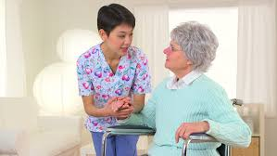
Practicing the dialog: Using clues

Slide 29
Nurse | : | Greet the patient with her complete name. Introduce yourself and the purpose of visit.
Patient | : | Oh, hello Shally. Just call me Wilma, please.
Nurse | : | Respond to the patient. And ask how the patient is feeling.
Patient | : | Not so good, actually. I couldn’t sleep well last night because my back is really aching.
Nurse | : | Acknowledge the pain and validate where the pain is.
Patient | : | This part, right here.
Nurse | : | Normalize the feeling by telling the patient you will do an observation on her. Ask if it is okay.
Patient | : | Sure, go ahead.
Nurse | : | Explain what you will do
(a while later) |  | (after the observation)
Nurse | : | Ask how the patient is feeling after the treatment.
Patient | : | Much better, thank you, Shally.
Nurse | : | Give encouragement to the patient and tell the patient that you will inform the doctor about this.
Patient | : | Thank you.
Nurse | : | Show your appreciation talking with the patient and inform her that you need to see other patients. Explain what the patient should do if she needs you.
Patient | : | Okay. Thanks.

Slide 30
Role Play

Slide 31
Review and Reflection

Slide 32
Review and Reflection
What are the communication strategies to introduce ourselves to a patient for the first time? (List down what you remember)
Introduce yourself in the complete name.
…. Etc.
What are the language expressions to:
Greet patient?
Introduce ourselves and purpose of visit?
Responding empathically to the pain described by the patient? (A, V, N, E)
Leaving the patient?
What new words or expressions did you learn today?

Slide 33
Cooling Down: Video Watching
https://www.youtube.com/watch?v=4peIFulusSk

Slide 34
Why do you want to be a nurse?
Can you list down different reasons why people in the video want to be a nurse?

Slide 35
Assignment 2
(Write your reflection in a paragraph of around 100 words).
From watching the video I learned ___ lessons.
First, I learned that ________________________________________________________________________________.
Another lesson that I learned is ________________________________________________________________________________.
In conclusion, I think nursing is ________________________________________________________________________________.

Slide 36
Remember
Good communication is an important part of the healing process.
Talking With Your Older Patient: A Clinician's Handbook

Slide 37
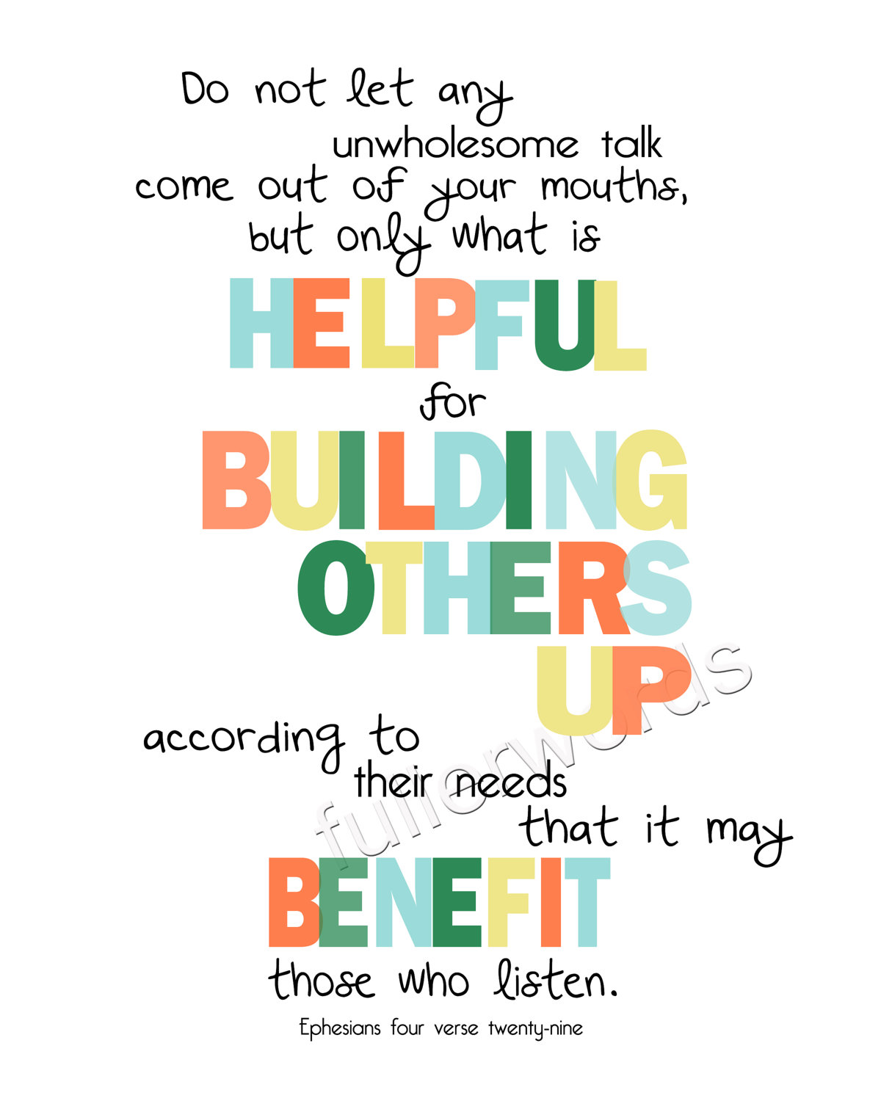
Ephesians 4: 29 ESV

