Slide 1
EFFECTIVE LEARNING

Slide 2
Interested or bored?
Smiling or frowning?
Sleepy or active?
Understand or confused?
Successful teaching and learning
Notes:
Smiling or frowning? Sleeping or active? Interested or bored?

Slide 3
So, ….
How?

Slide 4
Inspiring!

Slide 5
Digital life
https://newtheory.com/shocking-facts-about-the-millennial-generation/

Slide 6
Let them to do what they love

Slide 7
Helpful!
Easy to digest ; Provide learning guides

Slide 8
Provide Learning Guides
Questions
Instructions
Pictures
Examples
Discussion
Demo
Helpful!

Slide 9
Learning
Trying
Applying
Reflecting
Understanding
Observing
Experiencing
With guidance
Without guidance
Lessons Learned
Improvement
Innovation
Technology enhanced!
In classroom
Beyond classroom
Learning journal
(Digital and non-digital)
Create
Share
Publish
Notes:
Real case study, real situations

Slide 11
Collaborate
Sharing
Helping
Participate

Slide 12
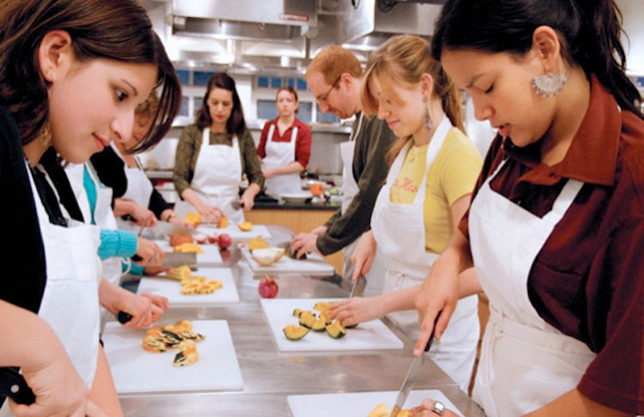
Applicable!

Slide 13
Apply beyond the classroom
Share
Wall bulletin
Do
Class Project
Community service
Poster
Newsletter
Clasroom Wall of fame
Play or performance
Games
Inviting guest speaker

Slide 14
Applicable!
Workplace
Learning

Slide 16
Relevant to Needs and Interest (Meaningful)
Relevant!

Slide 17
So, what are the lessons learned?

Slide 18
Summary: Effective teaching and learning!
I |  | H | E | A | R
Inspiring |  | Helpful | Engaging | Applicable | Relevant

