Slide 1
Unit 1 ADVERTISING
(Vocabulary)

Slide 2
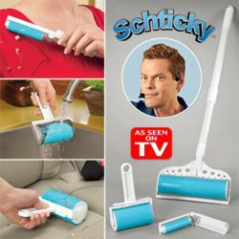
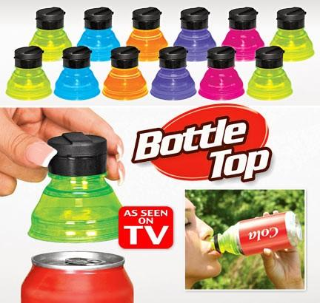
1. Infomercial
Gena was watching infomecials on TV. She ordered a frying pan that was advertised.

Slide 3
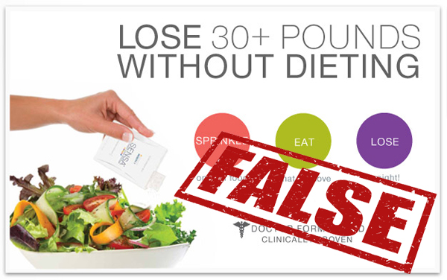
2. False Claim
She thinks the advertisers made false claims about the product because after she bought it, it didn’t work very well as advertised.

Slide 4
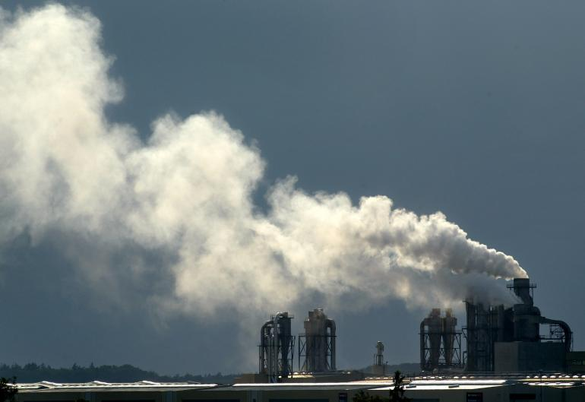
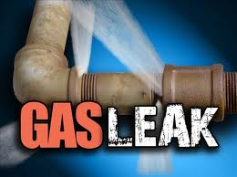
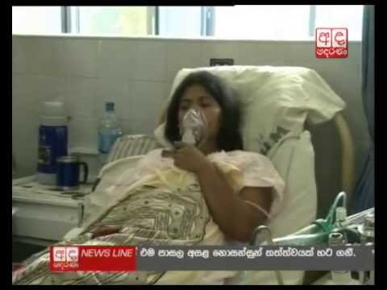
3. To be held liable
The Fertilizer company was held liable for the dangerous gas leaking from the factory and poisoned the people around the factory.

Slide 5
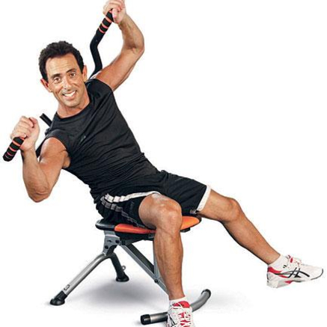
4. Ab machines
The new ab machines at the gym are very effective to flatten my stomach.

Slide 6
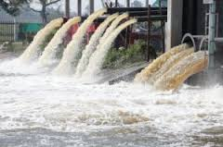
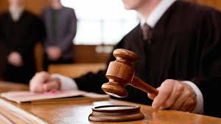
5. To sue
The people in the village sue the company for polluting the river with chemical waste.

Slide 7
6. Come on!
Expression that is used to tell someone to hurry.
Come on! We’re going to be late!
Expression that is used to tell someone that you don’t believe what they are saying.
Come on! Only a fool will believe what you said.

Slide 8
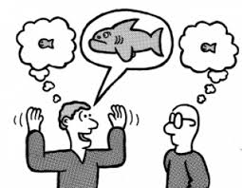
7. Exaggerate
Sarah said she watched 10 hours of TV yesterday. I know she exaggerated because I saw her to work in the morning and come home late.

Slide 9
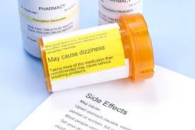
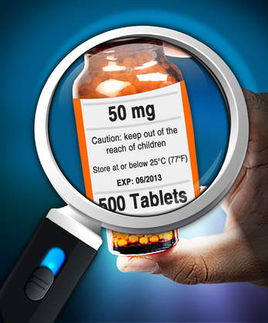
8. Fine Prints
Before you take any medicine, read the fine print on the label.

Slide 10
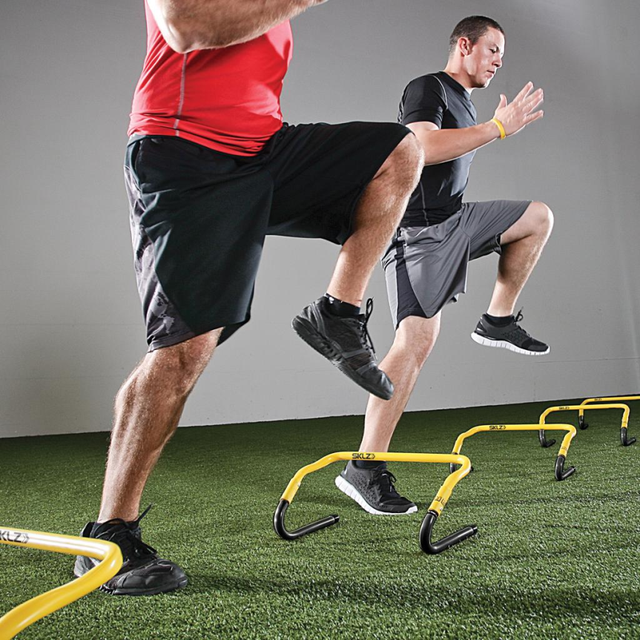
9. Vary
Let’s vary the speed of walking. We can try slow walk, then move on to faster walk.

Slide 11
Matching word/s with meanings
Activity 1

Slide 12
PRE-LISTENING VOCABULARY
Infomercial
False claims
To be held liable
Ab machines
Sue
Come on!
Exaggerate
Fine prints
Vary
Take to court for money
Long TV commercials to provide information
Exercise machine for the abdomen
Exclamation to ask someone to tell the truth
Make slightly different
Considered legally responsible
Make a fact bigger than it really is
Dishonest (not true) statement
Details in small prints

Slide 13
PRE-LISTENING VOCABULARY
Infomercial (b)
False claims (h)
To be held liable (f)
Ab machines (c)
Sue (a)
Come on! (d)
Exaggerate (g)
Fine prints (i)
Vary (e)
Take to court for money
Long TV commercials to provide information
Exercise machine for the abdomen
Exclamation to ask someone to tell the truth
Make slightly different
Considered legally responsible
Make a fact bigger than it really is
Dishonest (not true) statement
Details in small prints

Slide 14
Now, let’s try to guess what word should be inserted.
Activity 2

Slide 15
Number 1
Gena was watching __________ on TV. She ordered a frying pan that was advertised.

Slide 16
Number 2
She thinks the advertisers made __________ about the product because after she bought it, it didn’t work very well as advertised.

Slide 17
Number 3
The Fertilizer company __________ for the dangerous gas leaking from the factory and poisoned the people around the factory.

Slide 18
Number 4
The new __________ at the gym are very effective to flatten my stomach.

Slide 19
Number 5
The people in the village __________ the company for polluting the river with chemical waste.

Slide 20
Number 6
__________ Only a fool will believe what you said.

Slide 21
Number 7
Sarah said she watched 10 hours of TV yesterday. I know she __________ because I saw her to work in the morning and come home late.

Slide 22
Number 8
Before you take any medicine, read the __________ on the label.

Slide 23
Number 9
Let’s __________ the speed of walking. We can try slow walk, then move on to faster walk.

