Slide 1
The Hospital Team
Source: Oxford English for Careers, Nursing 1, By Tony Grice

Slide 2
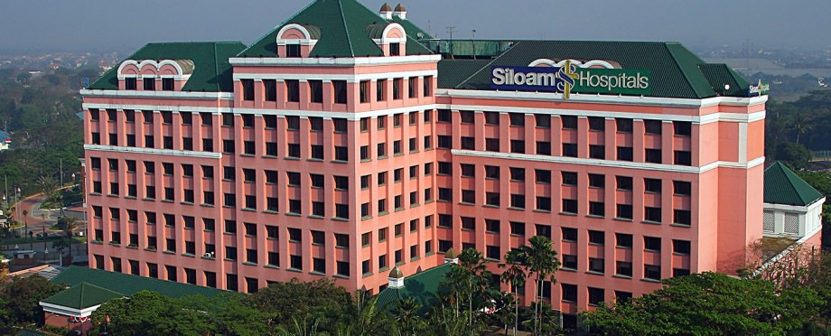
Have you been to the hospital?

Slide 3
A | ENT
B | Cardiology
C | Dermatology
D | Critical Care
E | Pediatric
1 |  | deals with sick children.
2 |  | gives intensive care to critically ill patients
3 |  | specializes in treating heart diseases.
4 |  | treats diseases of the skin.
5 |  | gives care to patients with ear, nose and throat problems.

Slide 4
F | Diagnostic Imaging (Radiology)
G | ENT
H | General Surgery
I | Haematology
J | Maternity
6 |  | performs a full range of imaging such as x-ray scans, mammography, ultrasound scan, angiography (x-ray for blood vessels), CT Scan (Scan that shows cross-section of the body) and MRI (3D Scan).
7 |  | gives care to patients with ear, nose and throat problems.
8 |  | performs operations on patients.
9 |  | studies blood disorders.
10 |  | provides antenatal care, care during childbirth and post-natal support.

Slide 5
K | Neurology
L | Obstetrics
M | Oncology
N | Opthamology
0 | Orthopaedics
11 |  | treats injuries and diseases of the musculoskeletal system, which includes bones, joints, ligaments, tendons, muscles and nerves
12 |  | provides cancer care treatment.
13 |  | deals with disorders of the nervous system, including the brain and spinal cord.
14 |  | provides services to treat eye problems.
15 |  | specializes in pregnancy and birth.

Slide 6
HOSPITAL TEAM

Slide 7
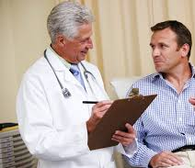
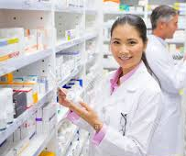
Meeting other medical professionals
A
B
C
Nurse –provides and manages the care of individual patients. They work closely with doctors and other healthcare professionals
Doctor – diagnoses symptoms and recommend treatment for patients. They have a wide range of clinical experience ranging from newly qualified junior doctors to senior consultants.
Pharmacist – prepares and gives medicines for patients.

Slide 8
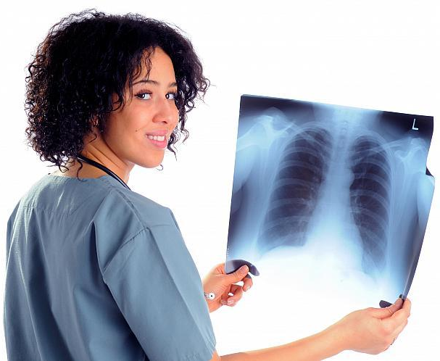
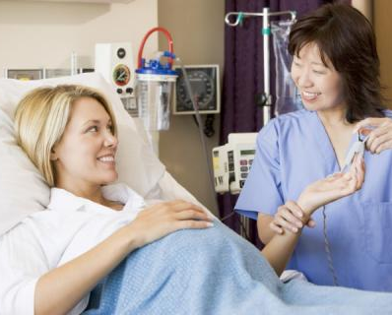
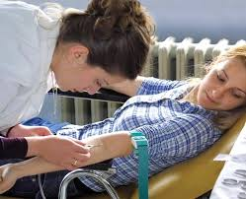
Meeting other medical professionals
D
E
F
4. Phlebotomist – takes blood from patients in wards or outpatient clinics for examination in laboratories.
5. Midwife – delivers babies/helps pregnant women.
6. Radiologist – takes and analyzes x-rays.Pharmacist – prepares and gives medicines for patients.

Slide 9
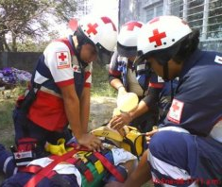
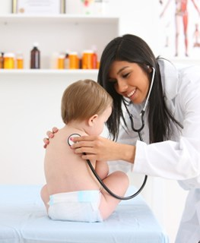
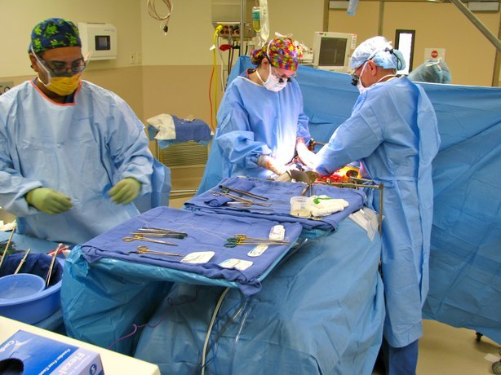
Meeting other medical professionals
G
H
I
7. Paediatrician – doctor who specializes in babies and children.
8. Surgeon – performs surgery.
9. Paramedic – a person trained to give first aid to the patients with the aim of stabilizing them before being admitted to the hospital.

Slide 10
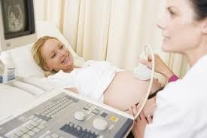
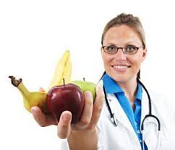
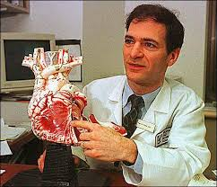
Meeting other medical professionals
J
K
L
10. Cardiologist – deals with disorders of the heart and blood vessels.
11. Obstetrician – specializes in pregnancy, labor, and pueperium (the time-period directly following childbirth).
12. Dietician – works with people to promote nutritional wellbeing, prevent food-related problems and treat disease.

Slide 11
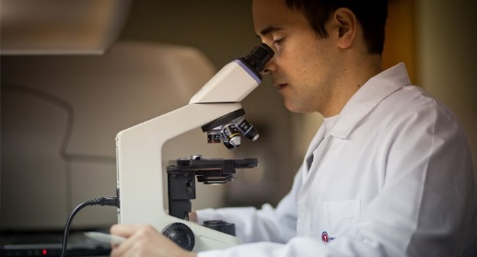
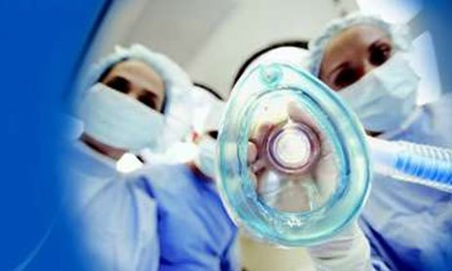
Meeting other medical professionals
M
N
O
13. Anaesthetist – puts people to sleep before surgery.
14. Physiotherapist – helps the patients to move again after na injury.
15. Lab Technician – analyzes body fluids/medical tests.

Slide 12
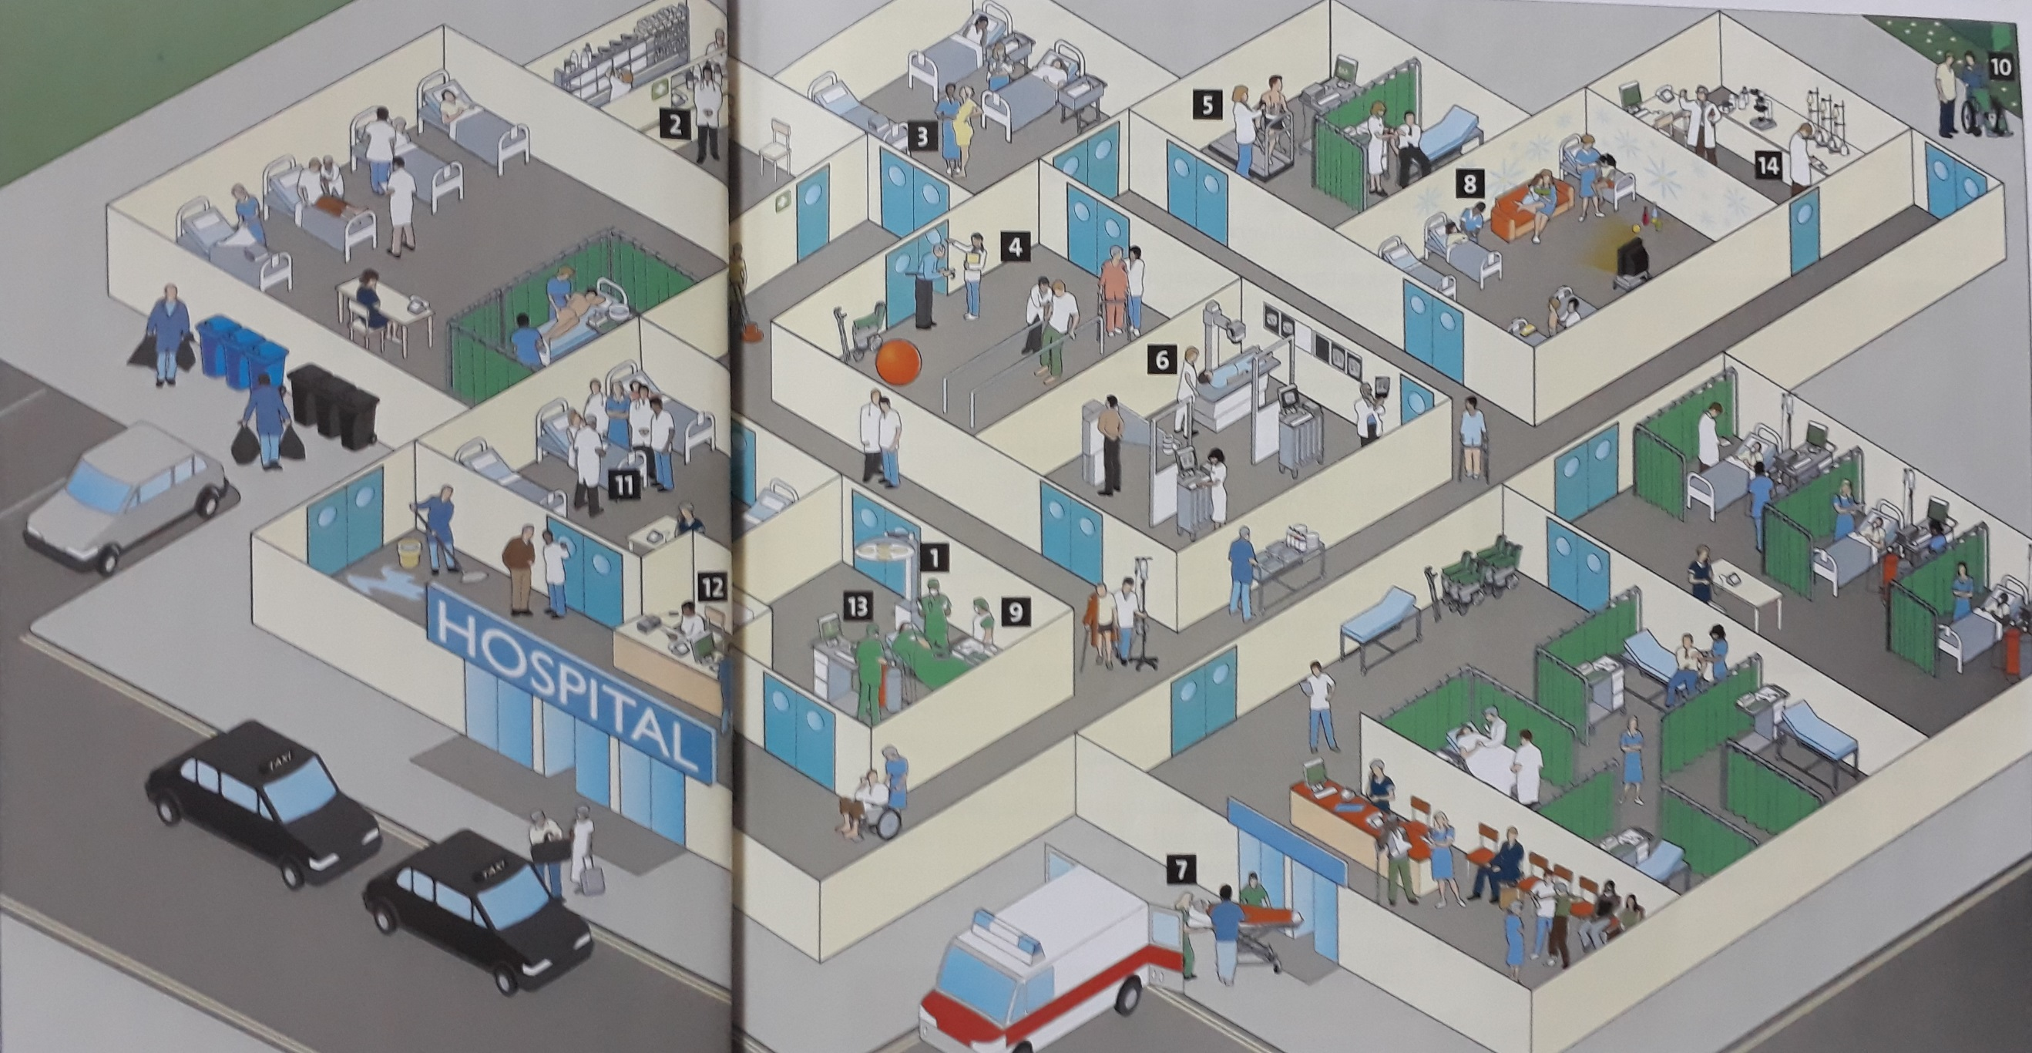
HOSPITAL DEPARTMENTS/UNITS?

Slide 13
MODEL DIALOG

Slide 14
Adams | : | Hello. Good morning. I don’t believe we’ve met. I’m dr. Brian Adams. I’m in Intensive Care Unit at Star Hospital, New York.
Harrison | : | Hi. Pleased to meet you, doctor. I’m Nurse Barbara Harrison from Sun Hospital, Ontario, Canada. I’m in Pediatric Unit.
Adams | : | Pleased to meet you too, Nurse.
Harrison | : | So, you are working in Intensive Care unit. How long have you been working in this unit?
Adams | : | About 5 years. What about you? How long have you been working in Pediatric Unit?
Harrison | : | Just 3 years. Nice talking to you, dr. Adams. Well, we have to go back to the seminar room. The seminar will start again in 5 minutes.
Adams | : | Okay. Let’s go inside.

Slide 15
Name
Job title (nurse, doctor, midwife, dentist, surgeon, dietician, pharmacist, radiologist, physiotherapist, …)
Unit/department/ward
Hospital
City
Country
How long you have been working there

Slide 16
Greetings
Hello.
Hi.
Good morning/afternoon/evening.
Introducing oneself
Name, profession, department, hospital, city, country
Pleased to meet you/Happy to meet you/Nice to meet you
I’m Nurse Alberto da Silva. I work in the Critical Care unit of Sunrise Hospital in Rome. Pleased to meet you
Responding to an introduction
Hello, Nurse da Silva.
Pleased to meet you too.
I’m dr. William Costner. I’m an anesthetist working in the General Surgery Department of Green Hospital, Sydney, Australia.

Slide 17
Small talks
After introducing ourselves, we usually continue with small talk (informal talk) to get to know each other better.
Some topics to discuss in small talks:
Talk about the job
How long have you been a/an (job)?
What do you exactly do in the hospital?
What do you like about your job?
Talk about the company/hospital
How long have you been working in the hospital?
What kind of hospital is your hospital?
How big is your hospital?
Talk about the place where you are from
I see. You are from Nairobi. Where is it?
Is it a big city?
What is the place famous for?
How long have you been working there?
Talk about the place you are in at the time of speaking
When did you arrive here?
What places have you visited here?
Talk about the event you attend together
Is this your first time attending this seminar/conference?
What do you think about the presenter/topic of the seminar?

Slide 18
Ending a conversation
Nice talking to you. Nice talking to you too.
I have to go now. See you again soon. Okay. Bye.

