Slide 1
Present Simple: Question Forms

Slide 2
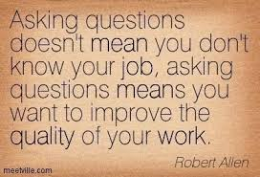
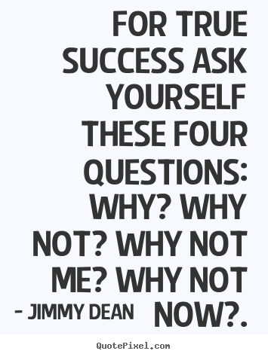

Slide 3
Match Questions with the Answers
No | Questions | Answers
1 | Who are you waiting for? | A. No, not yet
2 | What happened to Bob? | B. Home
3 | How long does it take you to get there? | C. He broke his leg.
4 | Can you tell me the time? | D. On January 1st, 1960
5 | Why did you call Mr. Brown? | E. Two hours.
6 | Would you like something to drink? | F. Next week.
7 | When will you travel to the United States? | G. My brother
8 | Have you done assignment 2? | H. A coke, please.
9 | Where are you going? | I. To invite him to dinner.
10 | When were you born? | J. It's 2 o'clock.

Slide 4
Types of questions
Yes-No
Requires a Yes or No answer
Starts with an auxiliary verb
Choice
Requires a choice answer
Starts with an auxiliary verb
Question Word
Tag (Confirmation)
Requires a confirmation with Yes or No
Starts with a statement, ends with the opposite tag
Requires an answer by giving relevant information
Starts with a question word

Slide 5
Yes-No Questions
Change the statements to Yes-No Questions.
e.g. Mira goes to Bandung on weekend.
Does Mira go to Bandung on weekend?
He loves this town.
They like soccer.
She can drive a truck.
There are many students in this class
She wakes up early.

Slide 6
Choice Questions
Do you like coffee or tea?
Are you a first-born, middle-born, last-born or an only child?
Is your favorite ice-cream flavor chocolate, vanilla, or strawberry?
Now make your own choice question to ask to your partner!

Slide 7
Confirmation Question (Tag Question)
You are a first-born, aren’t you?
Supply the correct tag to each question.
Brenda lives in Jakarta, ___ she?
They like Indonesian food, ___ day?
Shinta doesn’t like spicy food, ___ she?
Ben is in your class, ____ he?
The twins don’t have any brother and sister, ____ they?

Slide 8
Question-Word Questions
(____) are you so happy? because I have a birthday party.
(____) is sitting behind you? Rita
(____) do you go to school? by bus.
(____) does the first lesson begin? at 8.00 o'clock.
(____) is the police-station? in front of the park.
(____) is the weather like in Israel? It's hot.
(____) do the tickets cost? I don't know. Maybe 15 $.
(____) does your mom go to work in the morning? by taxi.
(____) does he usually have for lunch? rice and fish.
(____) wants to sing this song? Tamara .
(____) book is that? It's Maria's.
(____) do you have the longest holidays? in summer.
(____) can translate this word in English? I can.
(____) is your address? Main Street 16.
(____) can we buy milk here? at the supermarket.
Fill in the blanks with:
who, why, what, how, how much, how many, how old, when, where, whose.

Slide 9
References
English Exercises.org, http://www.englishexercises.org/makeagame/viewgame.asp?id=2066
Our happy school, http://ourhappyschool.com/mathematics/uses-numbers-our-daily-life
English Hilfen, http://www.englisch-hilfen.de/en/exercises/questions/answers_questions.htm

