Slide 1
Blended Learning
(Sandra Sembel)
ssembel@gmail.com

Slide 2
Blended Learning
Blended learning is NOT moving lessons online

Slide 3
Blended Learning?
Blending the best of two worlds of learning

Slide 4
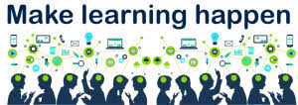
is a LEARNING program (formal or non-formal) that combines the power online digital media with traditional classroom methods to MAKE LEARNING HAPPEN.
Blended Learning

Slide 5
Blended Learning Models
Source: https://www.blendedlearning.org/models/

Slide 6
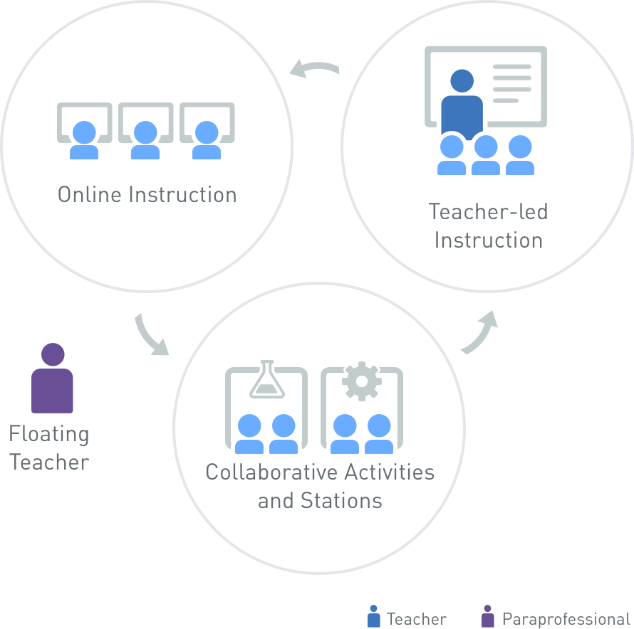
Rotation model

Slide 7
Flex model

Slide 8
A la Carte Model

Slide 9
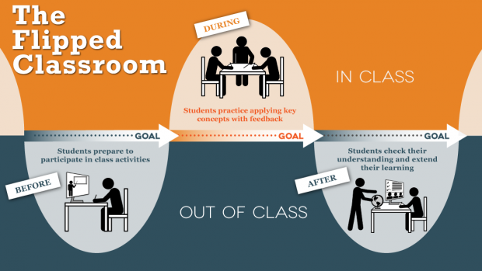

Slide 10
Remember ...
We prepare students for their FUTURE, not our PRESENT.
1

Slide 11
So, Remember ...
2
Use technology to support LEARNING (Don’t just simply fit learning for the sake of technology)

Slide 12
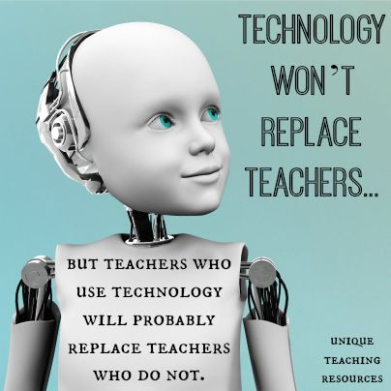
So, Remember ...
3

Slide 13
Our future or theirs?
We teach in DISCONNECTED departments. Learners live in INTERCONNECTED world. We teach INDEPENDENT lessons Learners live in INTERDEPENDENT world We teach learners about OUR PAST, OUR PRESENT AND OUR FUTURE Learners live in THEIR PRESENT AND THEIR FUTURE We teach what we KNOW Learners live to face the UNKNOWN We teach KNOW WHAT learning Learners live in KNOW WHERE learning We tell learners to respect the ULTIMATE SOURCE OF LEARNING: THE TEACHER Learners can get access to DIFFERENT SOURCES OF LEARNING

