Slide 1
Greet 10 people
sitting near you!

Slide 2
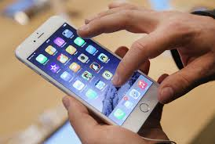
Ask the following three questions
Social media applications in your smart phone? How many -- Actively involved?
Time spent on digital technology and apps/day?
Smart phone? How many?

Slide 3
Share your findings with other groups
Smart phone? How many?
Social media applications? How many?
Time spent on digital technology and apps/day?

Slide 4
On average, teenagers spent more than seven-and-a-half hours a day involved with non-school-related technology. (2009)
https://www.psychologytoday.com/blog/the-power-prime/201209/children-s-immersion-in-technology-is-shocking
Teenage internet use (2014–15) indicate that 15- to 17-year-olds:
Are most likely to use the internet for social networking (91 per cent), entertainment (73 per cent) and formal education activities (73 per cent).
A study by the Australian Bureau of Statistics
https://parents.au.reachout.com/skills-to-build/wellbeing/technology-and-teenagers

Slide 5
Technology and intertwined. I believe when you passionately talk aboulearning have become harmoniously t learning and education, you cannot leave behind technology that supports them.
(Sandra Sembel)

Slide 6
Share your belief about learning and technology with the people around you!

