Slide 1
LANGUAGE IS GOD’S GIFT
Source: http://www.tworiverscc.org/language-is-gods-gift/#.WGsGt9J97IU
Accessed, Tuesday, January 3, 2017 @ 09:00 a.m.

Slide 2
Language comes from God. It is a gift of God to us. It actually reflects and reveals Him.

Slide 3
“Then God said, ‘Let there be light’; and there was light.” (Genesis 1:3)
The first time we see God speaking in the history of the world is at creation.
This simple sentence reveals to us the 3 main aspects of communication.
We have the One who speaks (God the Father)
We have the words that are spoken (God the Son)
We have the effects of the words (God the Spirit)
God the Father is the One who speaks. God the Son is the Word (He is spoken of as the Word in John 1). God the Spirit is associated with the effects of the words spoken.
Those three things are a part of every conversation you have, or article you might read.
You have one who is speaking or seeking to communicate.
You have actual words being spoken or written.
Then you have the effect of those words on those who hear or read them.
Therefore every conversation you have is a display of the Triune God. As a matter of fact you could not even have that conversation if not for the Triune God. It would be impossible.

Slide 4
That is truly amazing to me. Everyday, all day long, you and I are seeing evidence of the existence of our Creator and Sustainer–even in the simplest of conversations.
“By the word of the LORD the heavens were made, and by the breath of His mouth all their host.” (Psalm 33:6)

Slide 5
2 Corinthians 10:5 the Apostle Paul speaks of “taking every thought captive to the obedience of Christ.”
It is also a mandate to make sure our thoughts, ideas or opinions about every possible subject are being informed by the Word of God.
We should glorify the Lord with our words, be encouraging, and speak what is honest and truthful.

Slide 6
Language is a gift of God to man
Source: http://www.vindy.com/news/2011/jun/11/language-is-a-gift-of-god-to-man/
Published: Sat, June 11, 2011 @ 12:00 a.m.
Accessed, Tuesday, January 3, 2017 @09:31 a.m.

Slide 7
Language is a Gift of God to man
As a means of communication, language becomes the servant of the thought of man, and as such is the gift of God to man.
Why do we say the “gift of God?” Because the giver who gives to man, as we can see from the first Bible story of Adam and Eve, is in a position to also take it away from man.

Slide 8
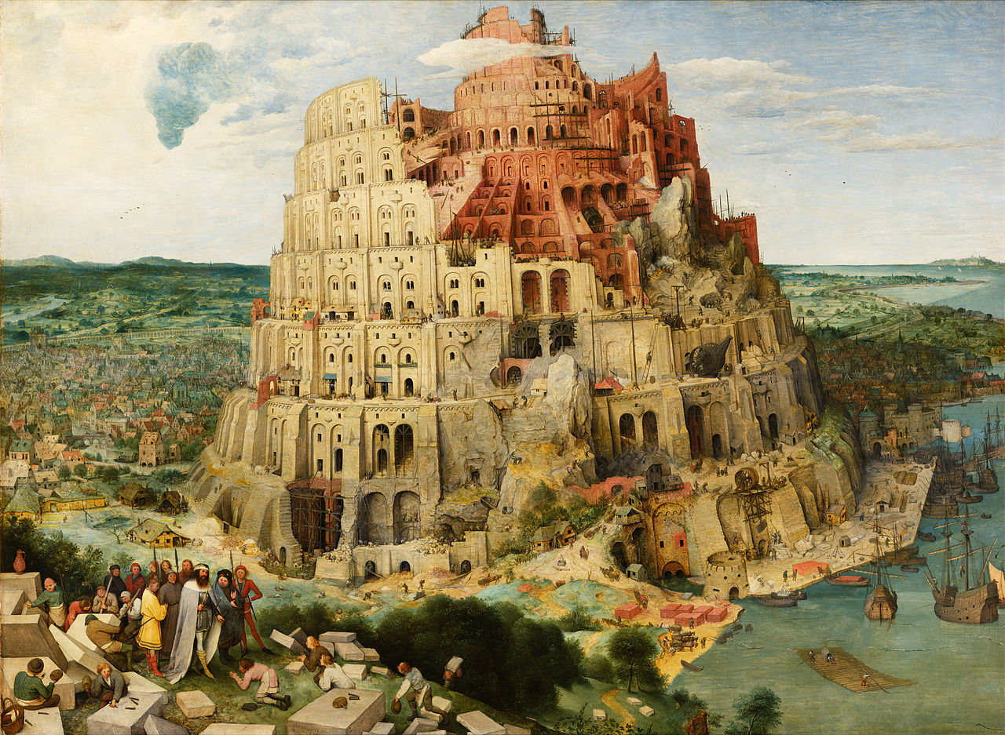
The Tower of Babylonian
God mixed the Babylonians language so that they couldn’t understand each other. For instance, as the builders began their work on the building site they failed to understand each other. They talked but their words did not make sense, and the more they talked the less they understood each other. All action and toil failed to come to fruition. Talk without sense is empty talk, as we can see in our time.
(Genesis 11:3-7)

Slide 9
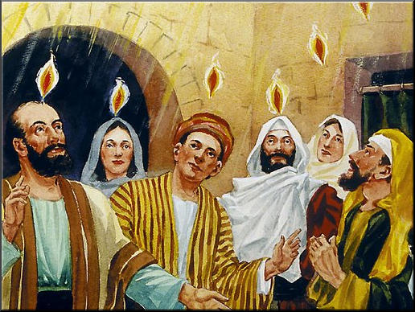
The Pentecost
In the case of Pentecost we read,”... and they began to speak in foreign tongues, even as the Holy Spirit prompted them to speak... and when this sound was heard, the multitude gathered and were bewildered in mind, because each heard them speaking in his own language” (Acts: 2:3-7).

Slide 10
Babel and Pentecost. The Bible registers two incidents regarding the language of man. One in the Old Testament and the other in the New Testament. The first one is known as, “The Tower of Babylon,” and the other “The Descent of the Holy Spirit.”
In the case of Babylon, man is being punished while in Jerusalem, man is given special gifts.
In both cases, the power comes from the same source — God.
In both instances, we see man with his limitations. Perhaps the difference is to be looked for and found in the attitudes of the two.

Slide 11
Language Arts in Christian Perspective by Dr. Laurel Hicks
Source: https://www.abeka.com/Resources/Articles/ArticlePDFs/ABBLanggArtinChrstPersp.pdf

Slide 12
Language is one of God’s greatest gifts to man. It is the single most important factor that binds men together as human beings, and it is one of the most important media that God has chosen to use in His dealings with man.
Martin Luther King, Jr.
’Twas a special gift of God that speech was given to mankind, for through the Word, and not by force, wisdom governs.
Language is a gift that God gave to no other earthly creature but man.
Language also permits human beings to relate to God in a way that no other part of creation can. Human language, in fact, originated as the creation of God.

