Slide 1
EFFECTIVE e-LEARNING

Slide 2
I |  | H | E | A | R
Inspiring |  | Helpful | Engaging | Applicable | Relevant

Slide 3
Inspiring!

Slide 4
From Start to Finish
Attention Grabbing
Motivating
Curiosity arousing
Unforgettable

Slide 5
Helpful!

Slide 6
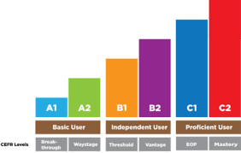
Chunking
Sequencing
Leveling

Slide 8
Physical engagement
Clicking
Hearing
Watching
Touching
Cognitive engagement
Q & A
Problem solving
Quizzes
Case Study
Emotional engagement
Story illustration – Scenario
Encouraging feedback
Needs and interests

Slide 9
Applicable!

Slide 10
Applicable
Observing
Trying
Using

Slide 12
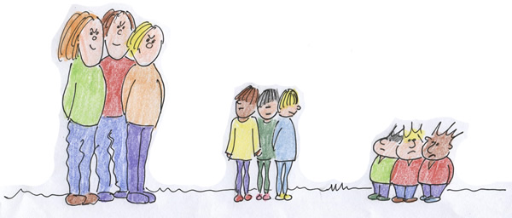
Needs and Interests

Slide 13
So, what are the lessons learned?

